Slide 1
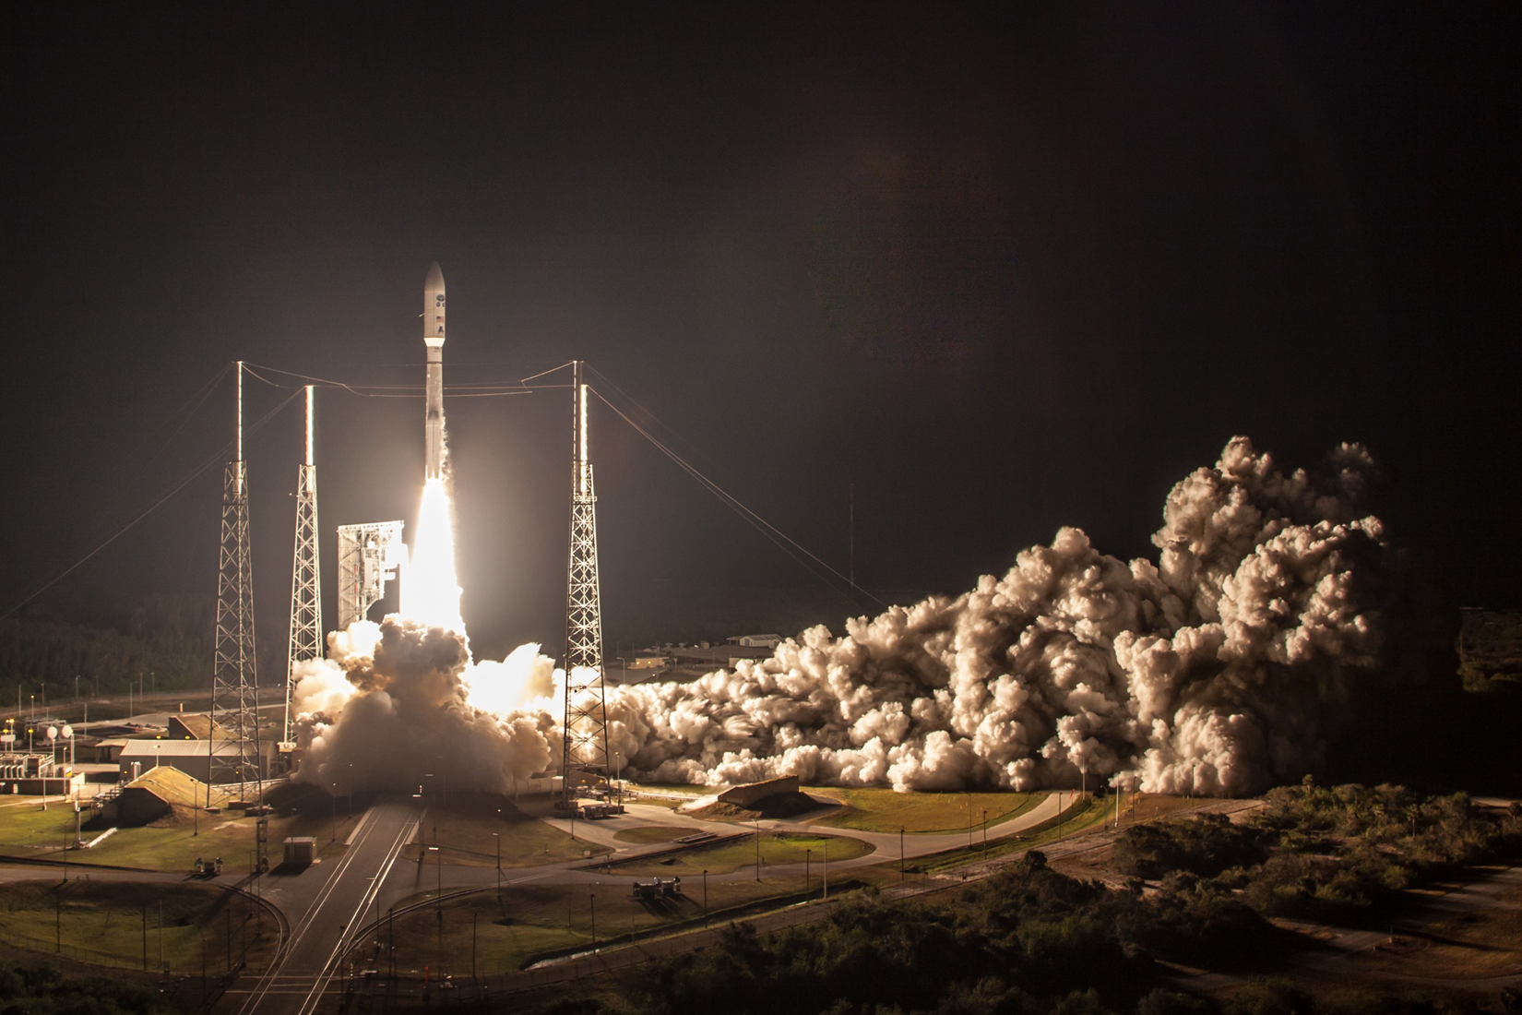
Peer Stakeholder-Product Validation Review (PS-PVR) for the
Full Validation Maturity of GOES-16 ABI L1b Products
GOES-R Calibration Working Group
June 1, 2018
STAR members: S. Guo, R. Iacovazzi, V. Kondratovich, H. Qian, X. Shao, Z. Wang, X. Wu, H. Yoo, F. Yu
With inputs from T. Schmit, D. Linsey, F. Padula, A. Pearlman, M. Coakley, M. Gunshor, and other members and contributors

Slide 2
Presentation Outline
Introduction
ABI L1b Product Performance
Post-Launch Product Test (PLPT)
Progress Since Provisional Review
Assessment of Maturity
Summary and Recommendations

Slide 3
Presentation Outline
Introduction
ABI L1b Product Performance
Post-Launch Product Test (PLPT)
Progress Since Provisional Review
Assessment of Maturity
Summary and Recommendations

Slide 4
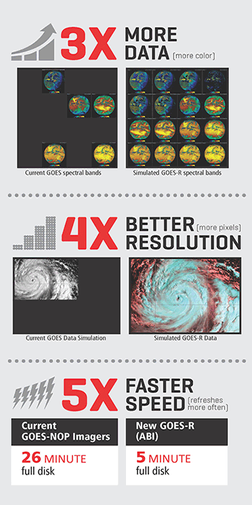
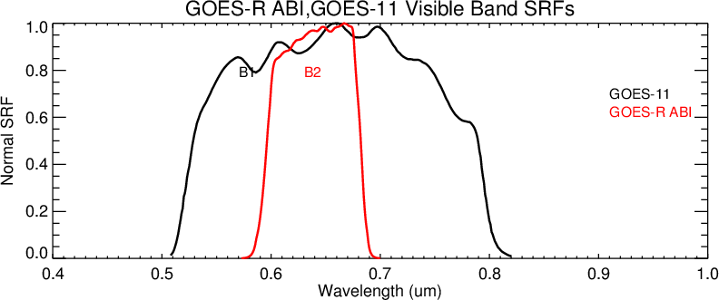
Mission Requirements …
Compared to Imager, ABI must provide …
  3 times more channels (5 –> 16)
  4 times finer spatially (4/1 km –> 2/0.5 km)
  5 times faster temporally (26 min –> 5 min)
… and the data must be better.
  Optimized (narrower) SRF
  Lower noise
  Calibrated solar bands
In summary, performance is hundreds times more demanding.
Instr. | S/N
AVHRR | 9
Imager | 250
ABI | 300
Harris Corp & T. Schmit
Notes:
In-band radiance for the red band is 132.21 for ABI, 348.87 for GOES-11(worst), and 252.92 for GOES-13 (best).
Inter-cal experience: spectral difference is the most difficult to reconcile. Requested to align ABI SRF with those of VIIRS. Did not approve for 0.47 band (between 0.445um and0.488um) and 0.64 band (can’t be narrower).

Slide 5
… drives the design …
Must have hundreds times more detectors
  Also cooler focal planes and better scan maneuvers etc.
Must have them work together
  Large 1-D detector arrays
  Multiple focal planes.
Onboard calibration for the solar bands.
Notes:
Polar orbiting sensor covers nearly globally, whereas the “full disk” from geostationary orbit is only 20% – 25% of the globe.
But to a sensor on geostationary orbit, the “geo” appears stationary.
Survey more than twice a day from one satellite.
Capture transient phenomena (clouds, smoke, temperature)
Observe dynamical interactions of the developing systems.
Faster – everything else being equal (or better).
60° local zenith – 60° from nadir.

Slide 6
… and poses calibration challenges …
Everything works as intended …
  Geometric calibration: Kalman Filter
    From “point as commanded” to “tell where pointed”
  Radiometric calibration: Uniformity
  Onboard calibration for solar channels.
… without unintended consequences
  New challenges with new technology.
  Old challenges to manifest in new ways.
    Thermal stress.
    Angular dependence of scan mirror emissivity.
Notes:
Polar orbiting sensor covers nearly globally, whereas the “full disk” from geostationary orbit is only 20% – 25% of the globe.
But to a sensor on geostationary orbit, the “geo” appears stationary.
Survey more than twice a day from one satellite.
Capture transient phenomena (clouds, smoke, temperature)
Observe dynamical interactions of the developing systems.
Faster – everything else being equal (or better).
60° local zenith – 60° from nadir.

Slide 7
… to be validated by the PLPTs …
Test ID | Short Title
ABI-L1b-PLPT-001 | IR Validation IASI CrIS
ABI-L1b-PLPT-002 | IR Validation CRTM
ABI-L1b-PLPT-003 | ZRDQ Performance
ABI-L1b-PLPT-004 | VNIR Validation VIIRS
ABI-L1b-PLPT-005 | VNIR Validation Sonora
ABI-L1b-PLPT-006 | VNIR Validation RVS
ABI-L1b-PLPT-007 | Monitoring
ABI-L1b-PLPT-008 | AD Converter
ABI-L1b-PLPT-009 | Low Light SNR
ABI-L1b-PLPT-010 | Image Navigation
ABI-L1b-PLPT-011 | Image Registration
ABI-L1b-PLPT-012 | Image Stitching
ABI-L1b-PLPT-013 | VNIR Validation DCC
ABI-L1b-PLPT-014 | Detector Uniformity Stability NSS
ABI-L1b-PLPT-015 | Validation SNO NSS
ABI-L1b-PLPT-016 | L2 Validation Support NSS
ABI-L1b-PLPT-017 | Lunar NSS
ABI-L1b-PLPT-018 | Detector Uniformity Investigation
ABI-L1b-PLPT-019 | Initial Solar Calibration
ABI-L1b-PLPT-020 | IR Spatial Uniformity
Test ID | Short Title
ABI-L1b-PLPT-021 | SRF Verification
ABI-L1b-PLPT-022 | OOB Response
ABI-L1b-PLPT-023 | Polarization
ABI-L1b-PLPT-024 | Cal-to-Cal Repeatability
ABI-L1b-PLPT-025 | Linearity
ABI-L1b-PLPT-026 | Ghosting
ABI-L1b-PLPT-027 | Field Campaign – Aircraft
ABI-L1b-PLPT-028 | Field Campaign – Surface
ABI-L1b-PLPT-029 | VNIR Verification – Rayleigh
ABI-L1b-PLPT-030 | VNIR Verification – Uyuni
ABI-L1b-PLPT-031 | BDS
ABI-L1b-PLPT-032 | VNIR SNR & Dynamic Range
ABI-L1b-PLPT-033 | IR Cal Stability
ABI-L1b-PLPT-034 | MTF
ABI-L1b-PLPT-035 | Coherent Noise
ABI-L1b-PLPT-036 | IR SNR & Dynamic Range
Critical tests are in bold.
Experimental tests are in italic.

Slide 8

… captured in the RIMP
Planning
  Readiness, Implementation, and Management Plan (RIMP)
Execution
  Post-Launch Tests (PLT) – Beta Maturity
    Verification of instrument for required functionalities
    Planned adjustments
    Flight-Ground Integration
  Post-Launch Product Tests (PLPT) – Provisional Maturity
    Validation of products for intended applications
    Program-User Integration
  Extended Validation (XV) – Full Validation Maturity
    Comprehensive evaluation of operation in intended environment
    Phase into normal operation

Slide 9
Performance Baseline Validation Status:
Radiometric Performance
MRD ID | Description | Related PLPTs
737 | Product Measurement Accuracy: Long-term Drift | -01, -02, -04, -05, -07, -09, -13, -24, -25, -29
1493 | Product Measurement Accuracy: IR CONUS | -01, -02, -15, -21, -22, -24, -25
1496 | Product Measurement Precision: IR CONUS | -07
1503 | Product Measurement Accuracy: IR Full Disk | -01, -02, -15, -21, -22, -24, -25
1506 | Product Measurement Precision: IR Full Disk | -07
1513 | Product Measurement Accuracy: IR Mesoscale | -01, -02, -15, -21, -22, -24, -25
1516 | Product Measurement Precision: IR Mesoscale | -07
2120 | Product Measurement Accuracy: VNIR Bands | -04, -05, -06, -07, -08, -13, -14, -15, -16, -18, -19, -21, -22, -23, -24, -25, -27, -28, -29
2121 | Short-Term Measurement Accuracy: RSB Bands | -07, -19
2122 | Long-Term Measurement Accuracy: RSB Bands | -04, -05, -06, -07, -13, -15, -16, -17, -18, -19, -29
2158 | Product Measurement Precision: IR Bands | -07

Slide 10
Performance Baseline Validation Status:
Image Navigation and Registration
MRD ID | Description | Related PLPTs
522 | Navigation Error: Not in Eclipse | -10, -12
523 | Navigation Error: In Eclipse | -03, -10, -12
527 | Navigation Error: Sample Separation | -10
529 | Co-Registration Error (2km-to-2km bands) | -11, -12
530 | Co-Registration Error (2km-to-0.5km bands) | -11, -12
531 | Co-Registration Error (2km-to-1km bands) | -11, -12
532 | Co-Registration Error (1km-to-1km bands) | -11, -12
533 | Co-Registration Error (1km-to-0.5km bands) | -11, -12
535 | Sample Separation | -10, -11, -12
536 | Registration of Radiance Product (pixel-to-pixel within frame) | -10, -11, -12
538 | Registration Error (0.5km and 1km channel frame-to-frame) | -10, -11, -12
539 | Registration Error (2km channel frame-to-frame) | -10, -11, -12
Notes:
Changed descriptions to be more specific.

Slide 11
Performance Baseline Validation Status:
Image Quality and Operations
MRD ID | Description | Related PLPTs
506 | Radiometric Sensitivity and Dynamic Range | -20
519 | Radiometric Relative Accuracy: Swath-to-Swath, Detector-to-Detector, Channel-to-Channel, Calibration-to-Calibration | -14, -15, -17, -18, -19, -24
560 | Radiometric Accuracy: RVS | -06, -20
567 | Restricted Zone Low-Light Performance | -03
2118 | Continuity of Operations During Eclipse | -03
2130 | Product Quality Monitoring | -01, -02, -03, -04, -05, -06, -07, -08, -09, -10, -11, -12, -13, -14, -18, -19, -21, -22, -23, -24, -25, -29
2154 | Radiance Performance Continuity During Eclipse | -03
2156 | Low-Light Radiance SNR: 064 Band | -09

Slide 12
Presentation Outline
Introduction
Summary of ABI L1b Performance
Overview of PLPT
Progress Since Provisional
Assessment of Maturity
Summary and Recommendations

Slide 13
Overview (1/4)
High-level performance has been submitted in a spreadsheet with 13 tabs, …
ABI Performance Summary by GOES-R CWG, 2018-06-01
Required (MRD), Pre-Ship (vendor), Pre-Launch (Baseline), Post-Launch (Provisional), and Present (Full) performance
Exclude operational (frequency, coverage, etc.) and L2 (radiance etc.) performance.
1. Geometric Calibration
 | a. Navigation Error
 | b. Registration Error – Channel-to-Channel (CCR)
 | c. Registration Error – Pixel-to-Pixel Within Frame (WIFR)
 | d. Registration Error – Frame-to-Frame (FFR)
2. Radiometric Calibration
 | a. Noise
 | b. Precision
 | c. Repeatability
 | d. Accuracy
 | e. Dynamic Range
 | f. Radiometric Drift
 | g. Linearity
3. Spectral Calibration
 | a. Central Wavelength
4. Spatial Resolution
 | a. Modulation Transfer Function (MTF)

Slide 14
Overview (2/4)
… each with one or more tables …
Requirement
Cross Reference
Performance
Further Details

Slide 15
Overview (3/4)
… and the corresponding plots.

Slide 16
Overview (4/4)
Some plots of selected performance will be presented.
ABI Performance Summary by GOES-R CWG, 2018-06-01
Required (MRD), Pre-Ship (vendor), Pre-Launch (Baseline), Post-Launch (Provisional), and Present (Full) performance
Exclude operational (frequency, coverage, etc.) and L2 (radiance etc.) performance.
1. Geometric Calibration
 | a. Navigation Error
 | b. Registration Error – Channel-to-Channel (CCR)
 | c. Registration Error – Pixel-to-Pixel Within Frame (WIFR)
 | d. Registration Error – Frame-to-Frame (FFR)
2. Radiometric Calibration
 | a. Noise
 | b. Precision
 | c. Repeatability
 | d. Accuracy
 | e. Dynamic Range
 | f. Radiometric Drift
 | g. Linearity
3. Spectral Calibration
 | a. Central Wavelength
4. Spatial Resolution
 | a. Modulation Transfer Function (MTF)

Slide 17
VNIR Noise

Slide 18
VNIR Noise

Slide 19
VNIR Noise

Slide 20
VNIR Noise
Evaluation metrics
Provisional vs. Full Validation
Performance vs. requirement / baseline

Slide 21
VNIR Noise
Meet the requirement with large margin.
Mean has been stable.
064 Band is challenging.

Slide 22
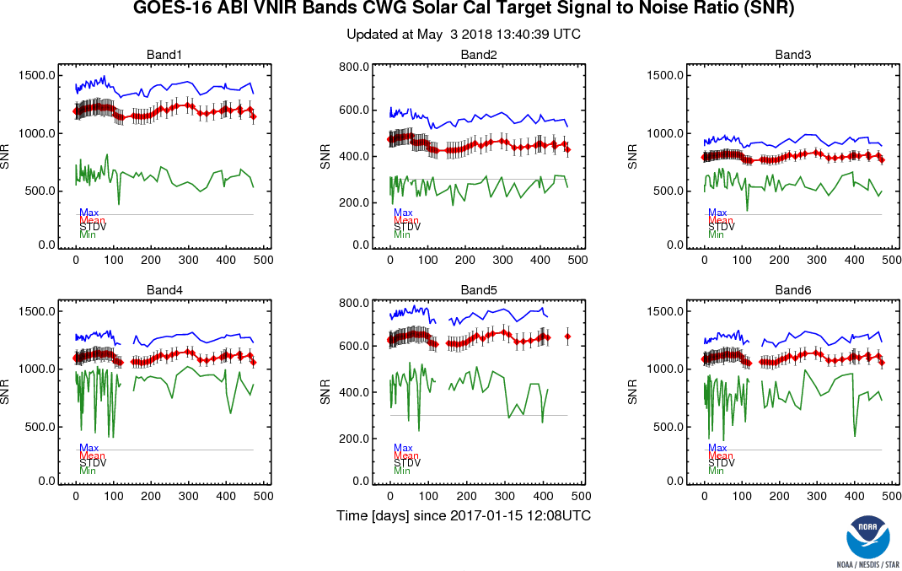
VNIR Noise Stability
Variations, esp. jumps, are largely due to those of solar calibration time.

Slide 23
IR Noise

Slide 24
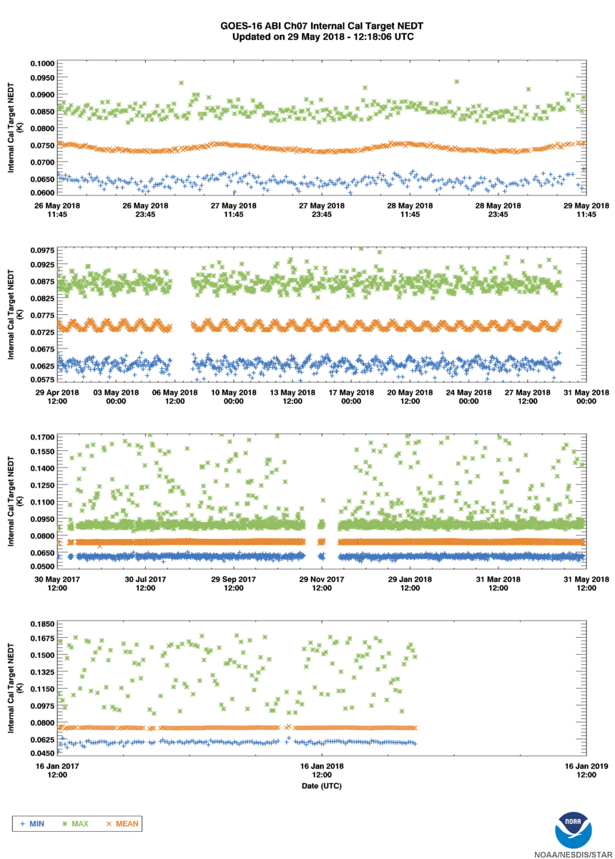
IR Noise Stability

Slide 25
VNIR Accuracy

Slide 26
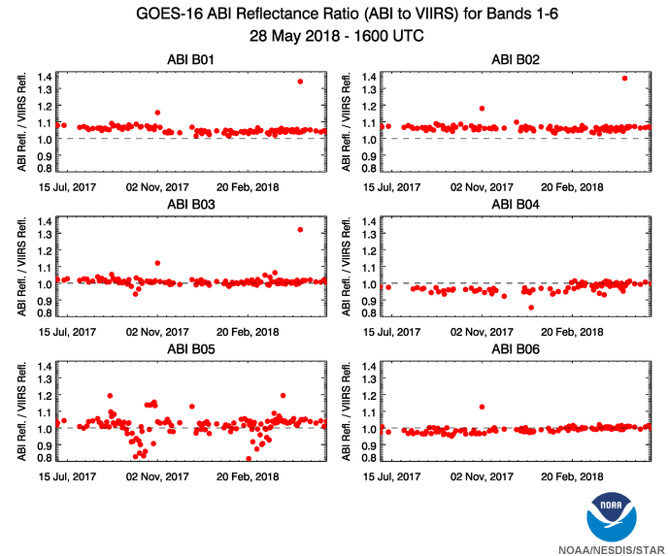
VNIR Accuracy Stability
Most outliers are due to GS, esp. for the 1.61μm and before Feb. 2018.

Slide 27
IR Accuracy

Slide 28
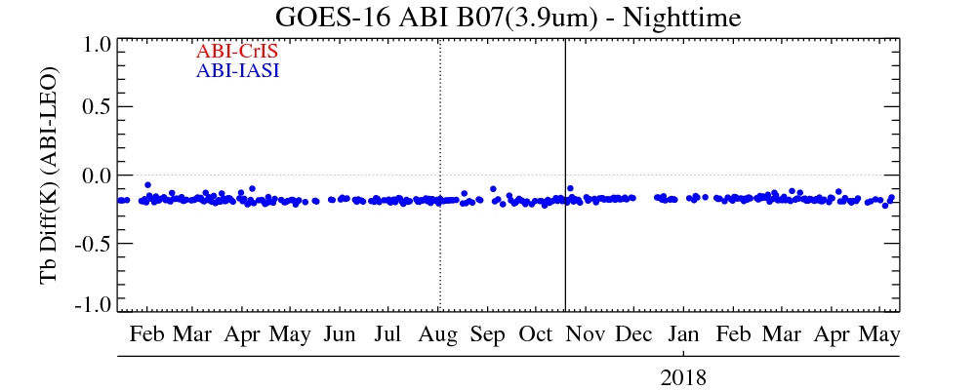
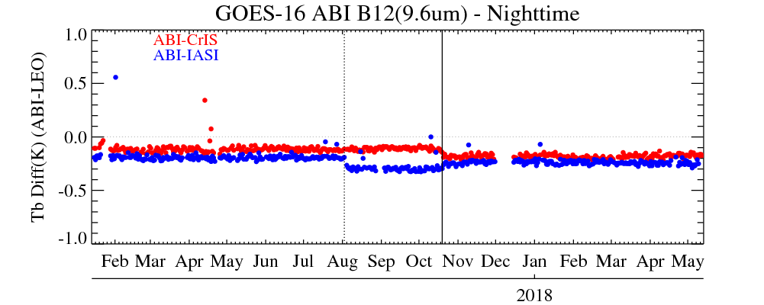
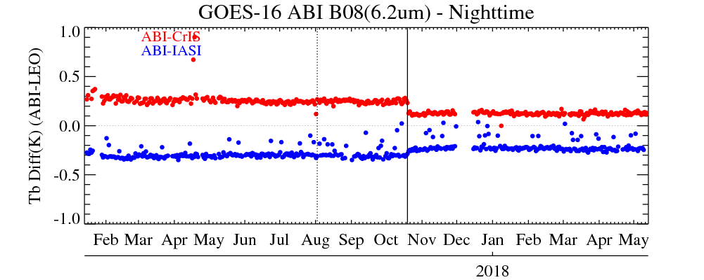
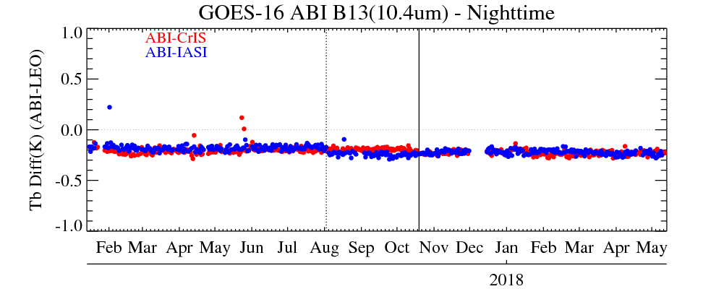
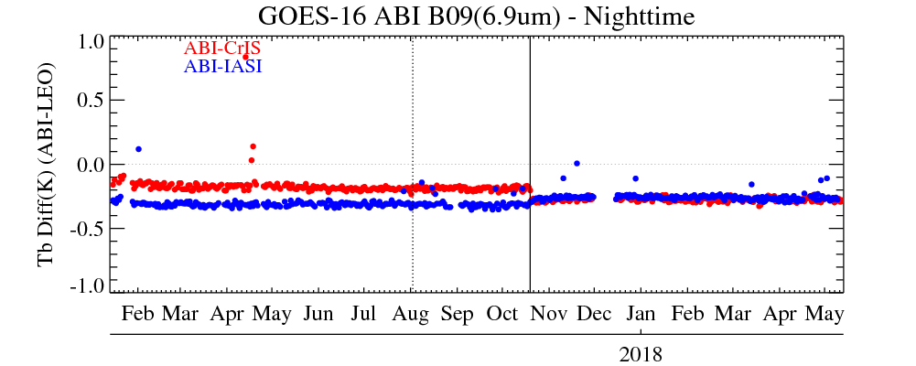
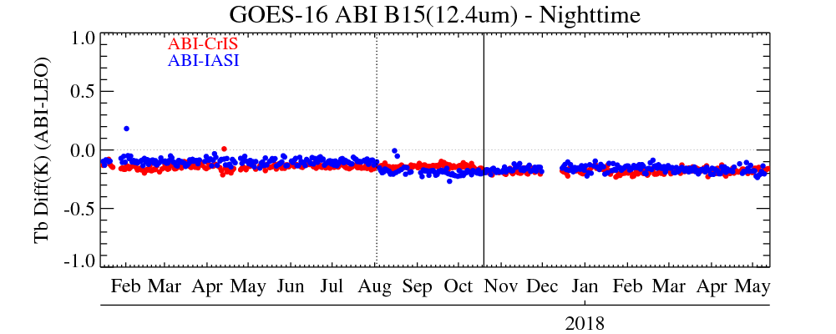
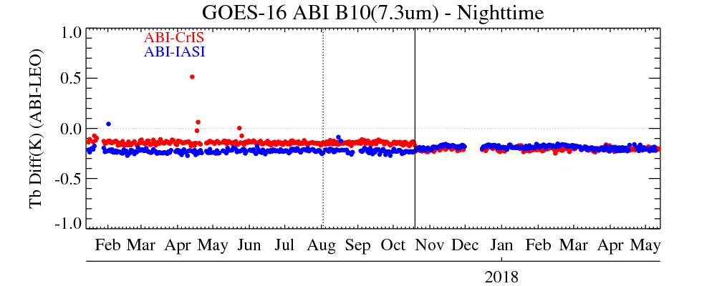
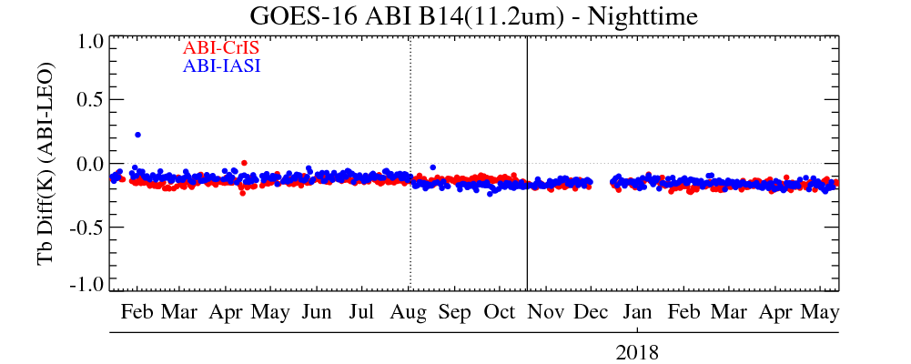
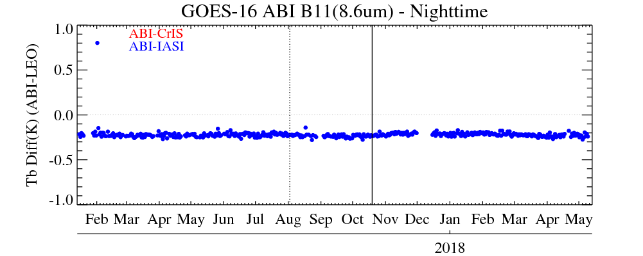
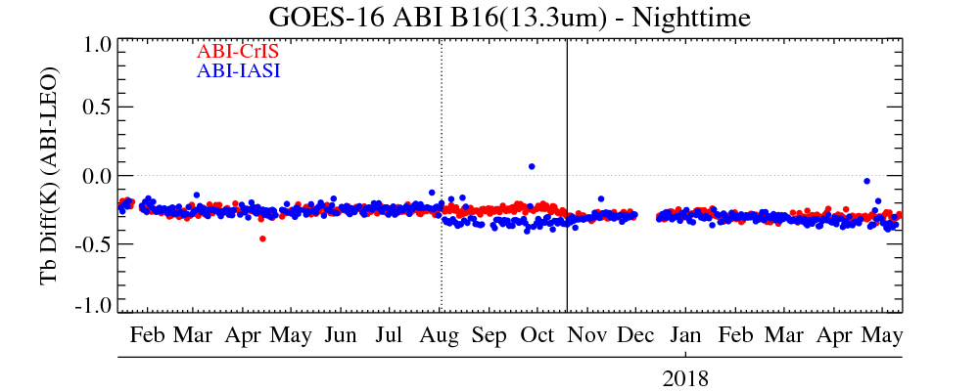
IR Accuracy Stability

Slide 29
Navigation Error (I)
“During Eclipse” is in the package but not presented.
Many did not meet the requirement or baseline at Provisional
  By a lot for some bands.
All do now
  With large margin.

Slide 30
Navigation Error (II)
CWG interprets the requirement as the average error in penumbra-umbra-penumbra time interval. Therefore, only IR channel navigation can be characterized.
We see up to 2x improvement from provisional to now.
However, these results are still above the baseline. We see the larger-than-average navigation errors locked on the penumbral times. We recommend better Kalman filter tuning and more frequent star observations.

Slide 31
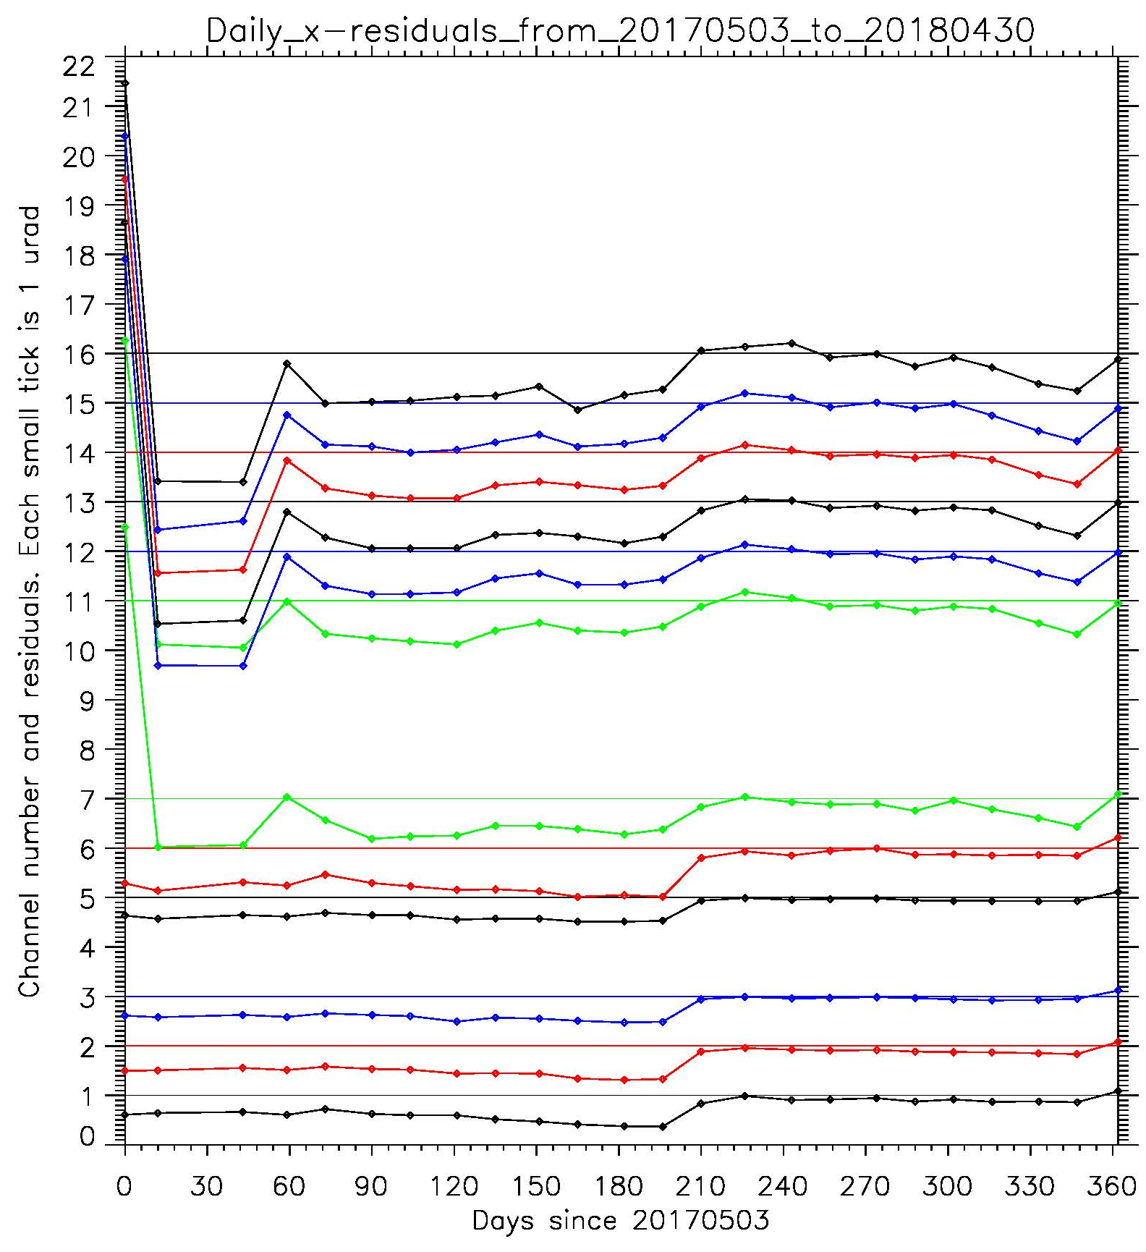
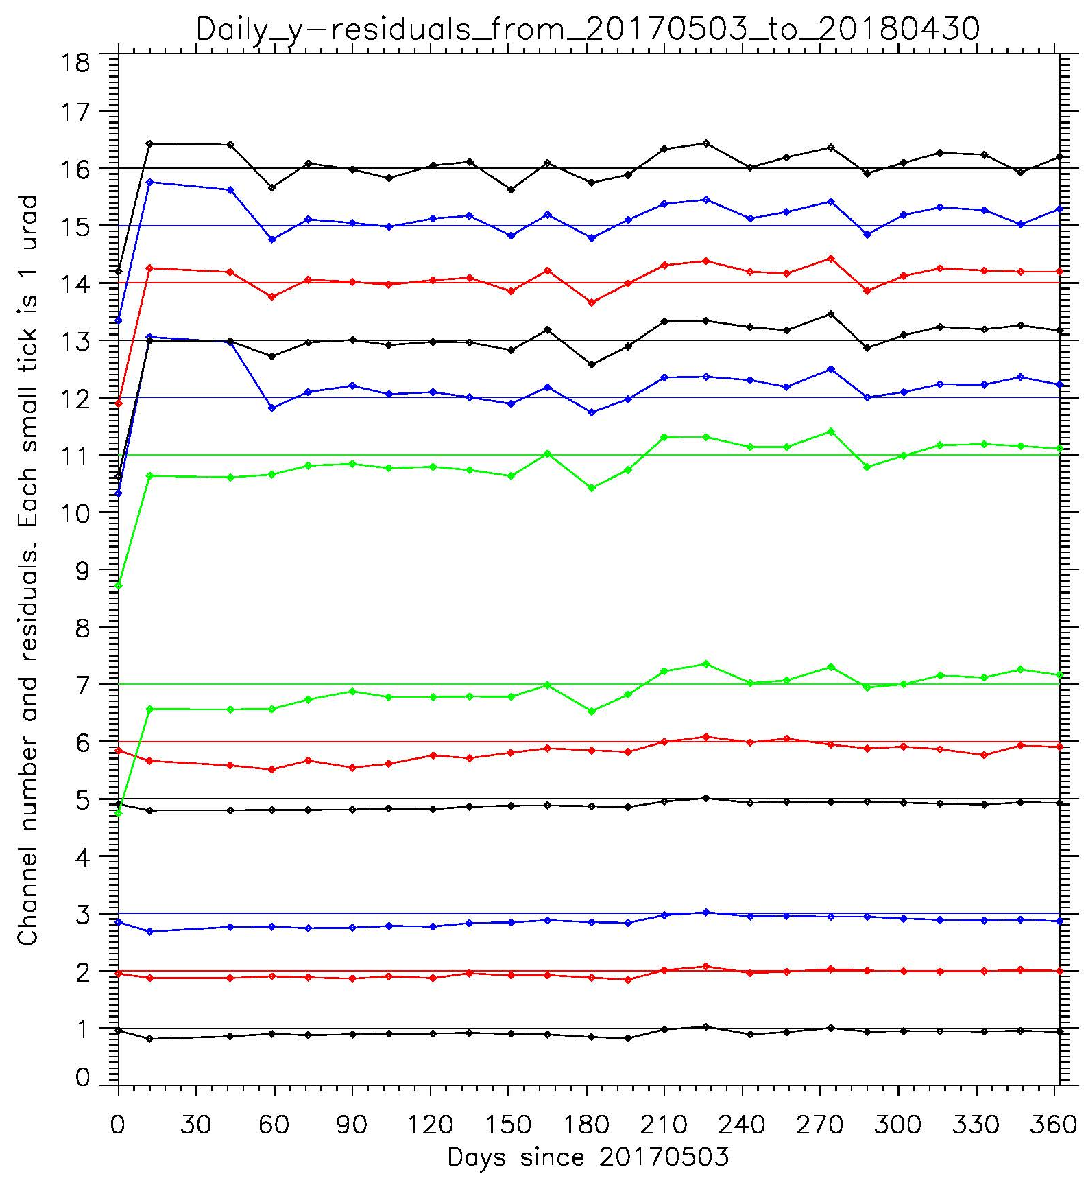
Nav Improvement – Residual
Errors were reduced by an order of magnitude in a year, after halved before then.
Notes:
Legend: ABI daily-average residuals, 2017-05-03 – 2018-04-30. Uninterrupted data stream is joined by lines. Empty spaces are data gaps.
Discussion: EW (x) and NS (y) navigation errors are reduced by the order of magnitude during that year (after they were halved before that period).

Slide 32
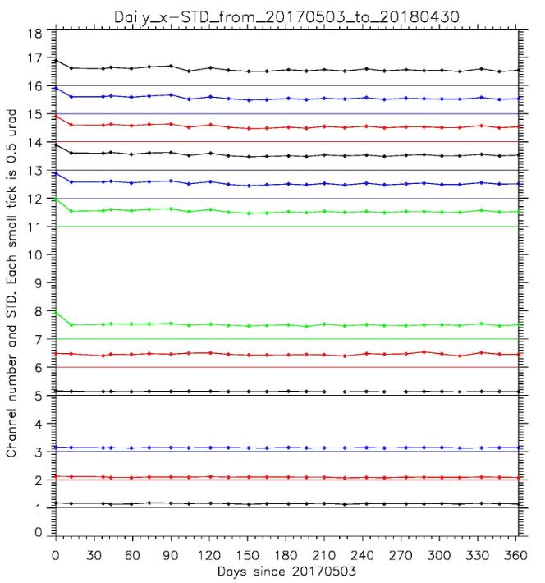
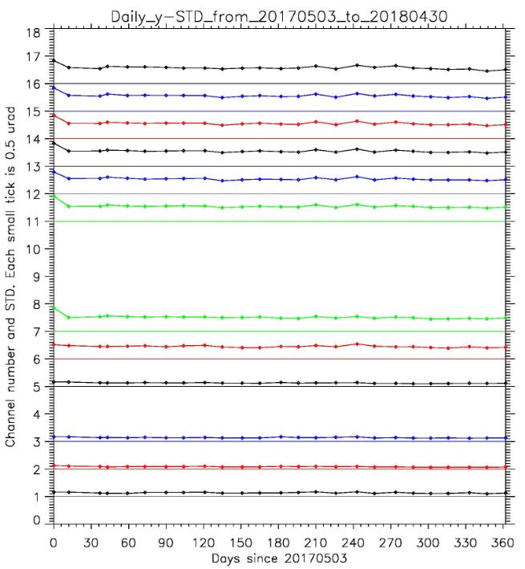
Nav Improvement – STD
STD were reduced to 1/3. Total Error = Residual + 3*STD
Notes:
Legend: ABI daily STDs are plotted. Uninterrupted data stream is joined by lines. Empty spaces are data gaps.
Discussion: EW (x) and NS (y) standard deviations (STD) have decreased 3 times during the period. This is as important as reduction in residuals because its contribution to the total error (3*STD) was also reduced by the order of magnitude.

Slide 33
Navigation Error (CCR)
Improved since Provisional …

Slide 34
Navigation Error (CCR)
… and better than required, but some not as good as expected.

Slide 35
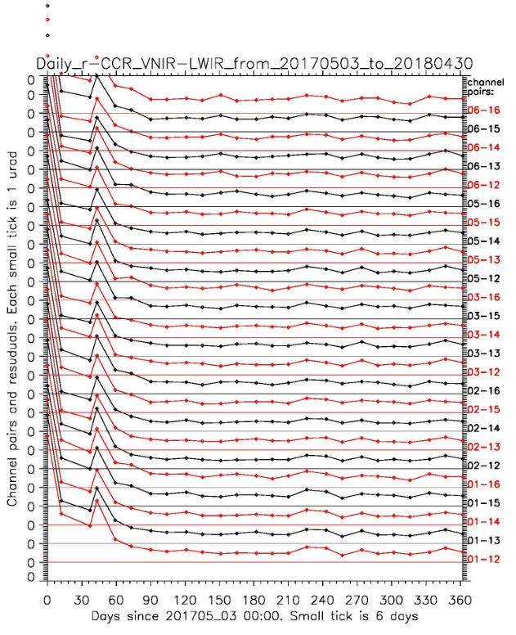
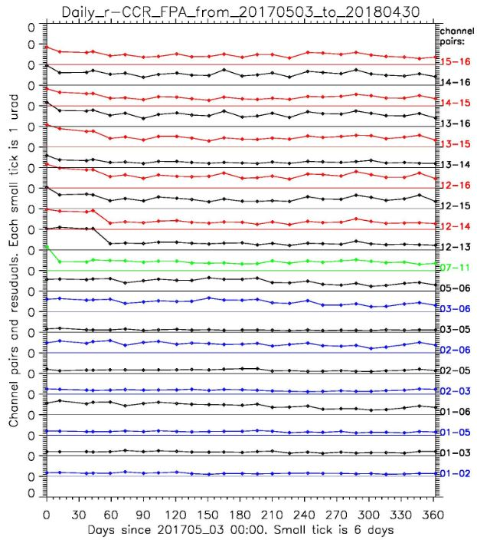
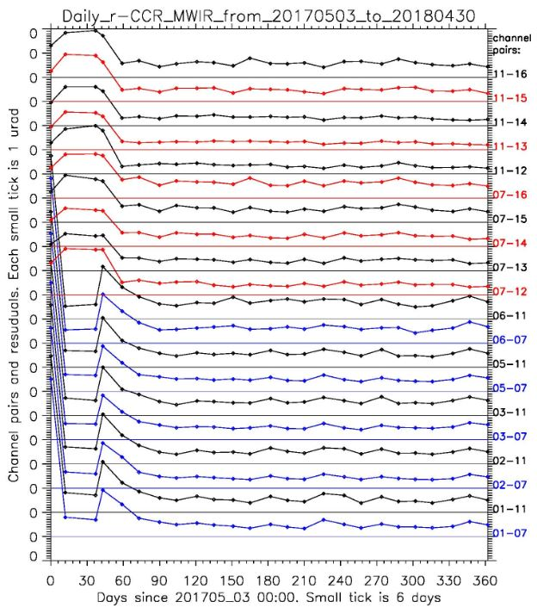
r-CCR Improvement
r-CCR STD in the package is not presented.
CCR for channel pairs in the same FPA (left panel) is better than those in different FPA (middle and right plots). That points to the Kalman filter as one of the focus points of the navigation.
Notes:
Legend: ABI daily-averaged vector Channel-to-Channel Registration (CCR) errors. Uninterrupted data stream is joined by lines. Empty spaces are data gaps.
LEFT plot shows CCR for within-FPA channel pairs, Red color for the channel pairs from LWIR, green for MWIR, and blue for VNIR. They alternate with black in order to distinguish neighboring plots.
MIDDLE plot shows the same for the channel pairs including MWIR window channels 7 and 11. Red color for the channel pairs from LWIR, and blue for VNIR. They alternate with black in order to distinguish neighboring plots.
RIGHT plot shows the same for VNIR-LWIR pairs of channels. Red color alternates with black in order to distinguish neighboring plots.
Discussion: CCR vector error shows less navigation problems for within-FPA pairs of channels (left plot) in comparison with the channel pairs from different FPAs (middle and right plots). That points to the Kalman filter as one of the focus points of the navigation.
Daily r-CCR, May 3, 2017 to April 30, 2018

Slide 36
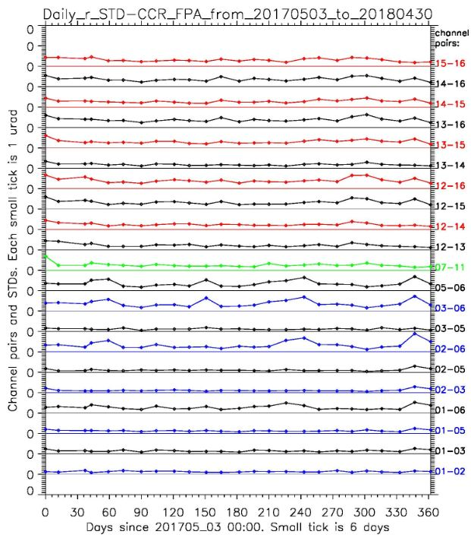
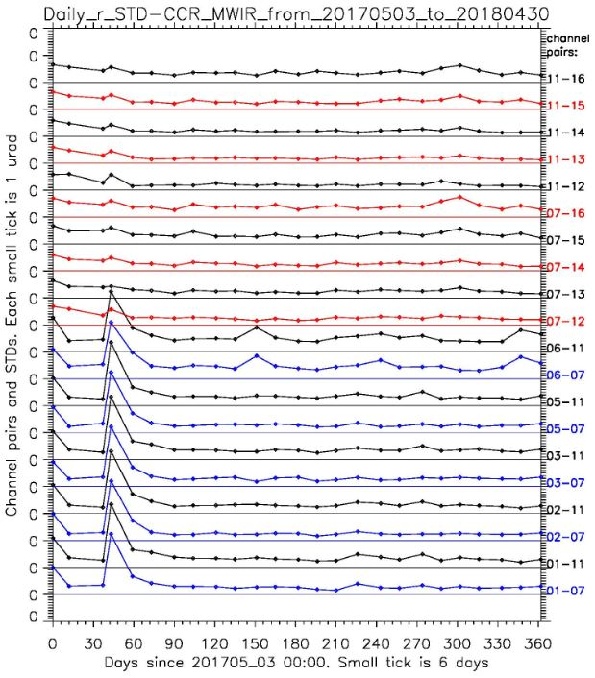
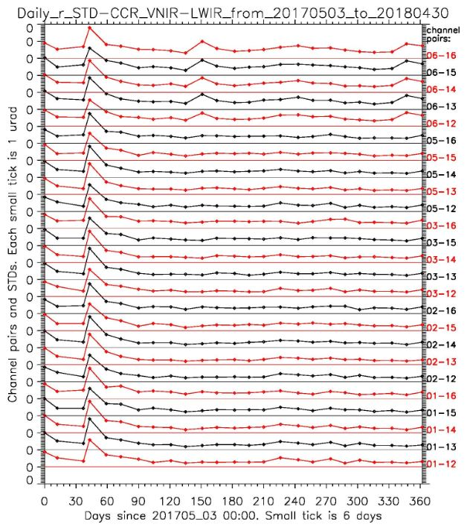
Daily r-CCR STD, May 3, 2017 to April 30, 2018
In-FPA
MWIR - VNIR & LWIR
VNIR - LWIR
Legend: ABI daily-averaged vector Channel-to-Channel Registration (CCR) error STDs are plotted. Time is UTC. No VNIR residuals during nighttime. Uninterrupted data stream is joined by lines. Empty spaces are data gaps.
LEFT plot shows CCR STD for within-FPA channel pairs, Red color for the channel pairs from LWIR, green for MWIR, and blue for VNIR. They alternate with black in order to distinguish neighboring plots.
MIDDLE plot shows the same for the channel pairs including MWIR window channels 7 and 11. Red color for the channel pairs from LWIR, and blue for VNIR. They alternate with black in order to distinguish neighboring plots.
RIGHT plot shows the same for VNIR-LWIR pairs of channels. Red color alternates with black in order to distinguish neighboring plots.
Discussion: CCR vector error STD shows less navigation problems for within-FPA pairs of channels (left plot) in comparison with the channel pairs from different FPAs (middle and right plots). That again shows the Kalman filter being one of the focus points of the navigation.

Slide 37
Navigation Error (FFR)
For the window channels only.
Sounding channels should show FFR similar to the window channels on the same FPA.
Better than requirements and baseline since provisional.
  Still, notable improvement in last year.

Slide 38
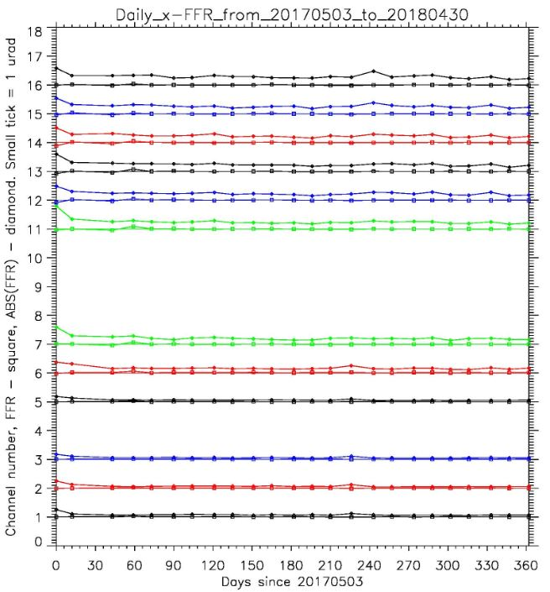
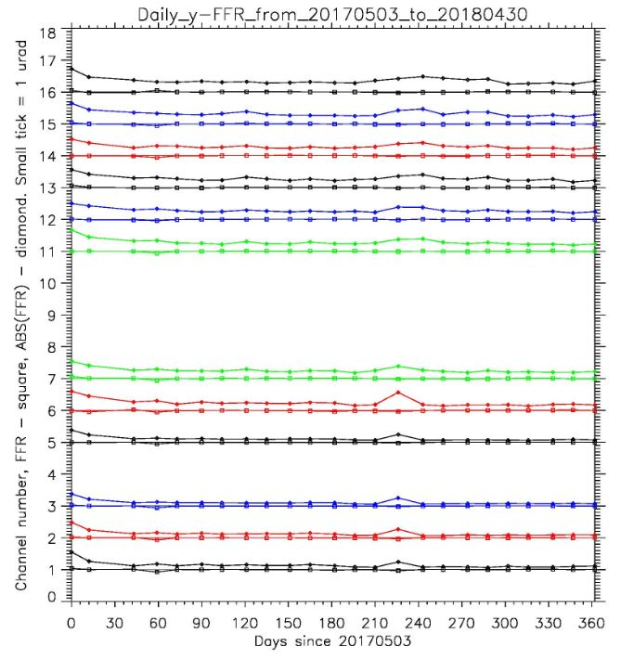
FFR Improvement
FFR STD in the package is not presented.
Daily FFRs are very close to zero, as expected. Daily absolute FFRs did normalize during first couple months of the period.
Notes:
Legend: ABI daily-averaged Frame-to-Frame Registration (FFR) errors are plotted (squares). Daily-averaged absolute FFR values are plotted as diamonds. Uninterrupted data stream is joined by lines. Empty spaces are data gaps.
Discussion: Daily FFRs are very close to zero, as expected. Daily absolute FFRs did normalize during first couple months of the period.

Slide 39
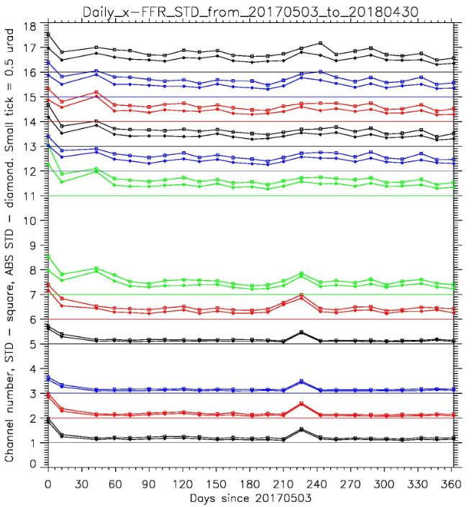
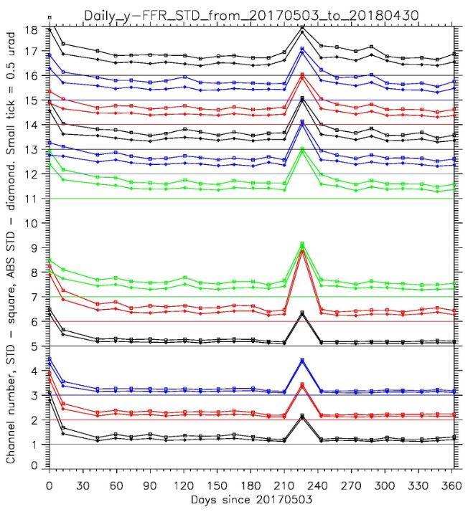
Daily FFR STD – May 3 2017 to April 30, 2018
Legend: ABI daily-average FFR STD are plotted. Time is UTC. No VNIR residuals during nighttime. Uninterrupted data stream is joined by lines. Empty spaces are data gaps.
Discussion: FFR STD shows more dynamics during the period, decreasing by the order of magnitude. That reflects better stability of ABI navigation.

Slide 40
Navigation Error (WIFR I)
CWG uses different methodology for WIFR error – we look at 24-hour averaged STD of the FD image. We do not compare pixel location in FD, CONUS, and MESO image.
Our measurement is in the family with requirements.
Provisional measurements used a single image, so they are not directly comparable with the full maturity data.
IPATS has found ½-pixel disagreement between position of MESO pixels and corresponding pixels in the FD and CONUS images. ADR 540 was formulated and scheduled for implementation in DO07.

Slide 41
Navigation Error (WIFR II)
We have estimated the image-averaged Swath-to-Swath Registration error (SSR).
Our measurements are in the family with requirements, though some image quality issues seem to be still present. It looks like the navigation process needs more star observations and better tuning of the Kalman filter.

Slide 42
Presentation Outline
Introduction
ABI L1b Product Performance
Post-Launch Product Test (PLPT)
Progress Since Provisional Review
Assessment of Maturity
Summary and Recommendations

Slide 43
Overview
ABI L1b performance were evaluated by PLPTs
  These are tests and tasks
  One test may address multiple performance.
  One performance may be addressed by multiple tests.
All PLPTs are not created equal.
  Critical vs. supportive / redundant.
  Mature vs. experimental /explorative.
Execution has also been adjusted to
  Instrument performance
  Personnel change – five left, three were difficult to replace.
Success if contributed to performance evaluation.
Following are 36 PLPTs, each summarized in one slide.
  And supported by its word document with more details.
But first, the airborne part of the Field Campaign.

Slide 44
Overview
ABI L1b performance were evaluated by PLPTs
  These are tests and tasks
  One test may address multiple performance.
  One performance may be addressed by multiple tests.
All PLPTs are not created equal.
  Critical vs. supportive / redundant.
  Mature vs. experimental /explorative.
Execution has also been adjusted to
  Instrument performance
  Personnel change – five left, three were difficult to replace.
Success if contributed to performance evaluation.
Following are 36 PLPTs, each summarized in one slide.
  And supported by its word document with more details.
But first, the airborne part of the Field Campaign.

Slide 45
GOES-R Airborne Science Validation Field Campaign
GOES-R Program Science

Slide 46
Overview
ABI L1b performance were evaluated by PLPTs
  These are tests and tasks
  One test may address multiple performance.
  One performance may be addressed by multiple tests.
All PLPTs are not created equal.
  Critical vs. supportive / redundant.
  Mature vs. experimental /explorative.
Execution has also been adjusted to
  Instrument performance
  Personnel change – five left, three were difficult to replace.
Success if contributed to performance evaluation.
Following are 36 PLPTs, each summarized in one slide.
  And supported by its word document with more details.
But first, the airborne part of the Field Campaign.

Slide 47
… to be validated by the PLPTs …
Test ID | Short Title
ABI-L1b-PLPT-001 | IR Validation IASI CrIS
ABI-L1b-PLPT-002 | IR Validation CRTM
ABI-L1b-PLPT-003 | ZRDQ Performance
ABI-L1b-PLPT-004 | VNIR Validation VIIRS
ABI-L1b-PLPT-005 | VNIR Validation Sonora
ABI-L1b-PLPT-006 | VNIR Validation RVS
ABI-L1b-PLPT-007 | Monitoring
ABI-L1b-PLPT-008 | AD Converter
ABI-L1b-PLPT-009 | Low Light SNR
ABI-L1b-PLPT-010 | Image Navigation
ABI-L1b-PLPT-011 | Image Registration
ABI-L1b-PLPT-012 | Image Stitching
ABI-L1b-PLPT-013 | VNIR Validation DCC
ABI-L1b-PLPT-014 | Detector Uniformity Stability NSS
ABI-L1b-PLPT-015 | Validation SNO NSS
ABI-L1b-PLPT-016 | L2 Validation Support NSS
ABI-L1b-PLPT-017 | Lunar NSS
ABI-L1b-PLPT-018 | Detector Uniformity Investigation
ABI-L1b-PLPT-019 | Initial Solar Calibration
ABI-L1b-PLPT-020 | IR Spatial Uniformity
Test ID | Short Title
ABI-L1b-PLPT-021 | SRF Verification
ABI-L1b-PLPT-022 | OOB Response
ABI-L1b-PLPT-023 | Polarization
ABI-L1b-PLPT-024 | Cal-to-Cal Repeatability
ABI-L1b-PLPT-025 | Linearity
ABI-L1b-PLPT-026 | Ghosting
ABI-L1b-PLPT-027 | Field Campaign – Aircraft
ABI-L1b-PLPT-028 | Field Campaign – Surface
ABI-L1b-PLPT-029 | VNIR Verification – Rayleigh
ABI-L1b-PLPT-030 | VNIR Verification – Uyuni
ABI-L1b-PLPT-031 | BDS
ABI-L1b-PLPT-032 | VNIR SNR & Dynamic Range
ABI-L1b-PLPT-033 | IR Cal Stability
ABI-L1b-PLPT-034 | MTF
ABI-L1b-PLPT-035 | Coherent Noise
ABI-L1b-PLPT-036 | IR SNR & Dynamic Range
Complete. Report has been submitted.
Critical tests are in bold.
Experimental tests are in italic.
Being complete. Results have been used.
Incomplete. Negligible impact.
Incomplete. Non-negligible impact.

Slide 48
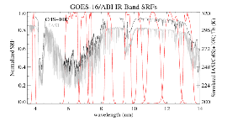
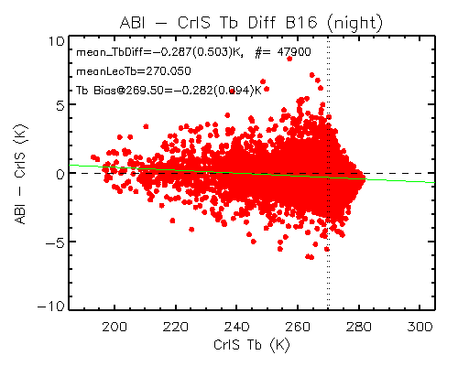
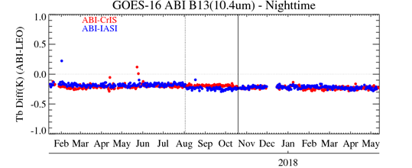
ABI-L1b-PLPT-001
IR Validation IASI & SNPP-CrIS
Objective
Validate thermal emissive band radiances by comparison with coincident LEO IR hyperspectral measurements, using IASI and CrIS data collocated in time, space, spectrum, and viewing geometry as reference (per Global Space based Inter-Calibration (GSICS) algorithm).
Related Requirements
MRD 737, 1493, 1503, 1513, 2130
Methodology
GEO-LEO collocated condition:
Time difference: <7.5 minutes for Mode 3 FD data
Viewing geometry difference: |cosine of VZN difference| < 1%
Geolocation: 7x7 array size of ABI pixels centered with the matched LEO pixels used to simulated the LEO’s foot-print
Spectral: LEO spectra convolved as “pseudo-pixel”.
Same targets: CoV of “pseudo-pixel” and 3x3 “pseudo-pixels” ABI radiance < 3%
Results
Summary
Mean Tb bias < 0.3K to CrIS and IASI for all IR bands
No strong scene dependent Tb bias
No apparent scan angle or geolocation dependent Tb bias
No apparent diurnal calibration variation
Periodic infrared calibration anomaly (PICA) corrected after the update of the scan mirror emissivity look-up-tables on 10/19/2017
Daily mean bias between ABI and CrIS (in red) and IASI (in blue) at night. Update of IASI calibration (for the quadratic term, 08/02/2017) and ABI calibration (for scan mirror emissivity, 10/19/2017) were marked by dotted and solid lines, respectively.
Complete

Slide 49
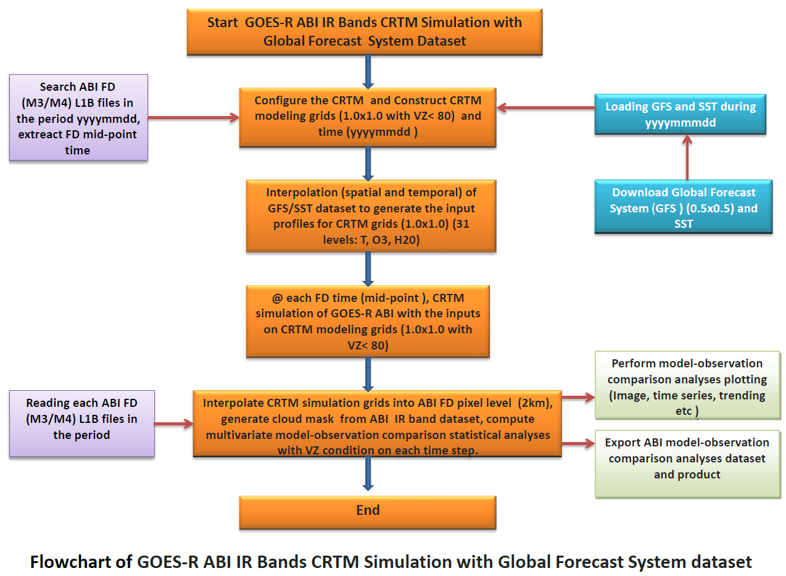
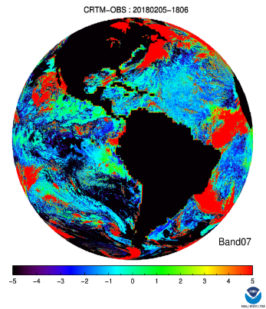
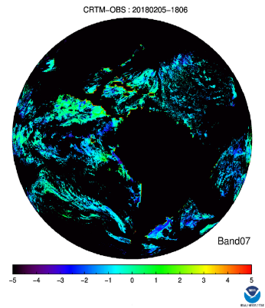
ABI-L1b-PLPT-002
Validation of GOES-16 ABI IR with CRTM
Objective
Verify calibration stability and study diurnal variation for ABI IR bands with CRTM as reference
Related Requirements
MRD737 (Long-term radiance drift);
MRD1493/MRD1503 MRD1513(Product Measurement Accuracy);
MRD2130 (The GOES-R Ground Segment shall monitor the quality of all products).
Methodology
Flowchart of GOES-R ABI IR Bands CRTM Simulation
Results
Link for CRTM simulation:
https://www.star.nesdis.noaa.gov/GOESCal/G16_ABI_CRTM_OBS_daily.php
Summary
CWG has built a tool with CRTM simulation for GOES-16 ABI IR bands.
ABI IR bands O-B Bias is band-dependent.
Two kinds of bias was identified: a constant bias and diurnal bias. Band07 has a large bias <2K diurnal variation. Band11 has a constant bias 0.8K, but 0.2K diurnal variations bias. Other bands 08, 09, 10, 12, 16 don’t show diurnal variation pattern.
Figure 2 Example of BT bias between CRTM and GOES-16 Band07 observation (-75.2°W), right plot with cloud mask and land sea mask.
Success

Slide 50
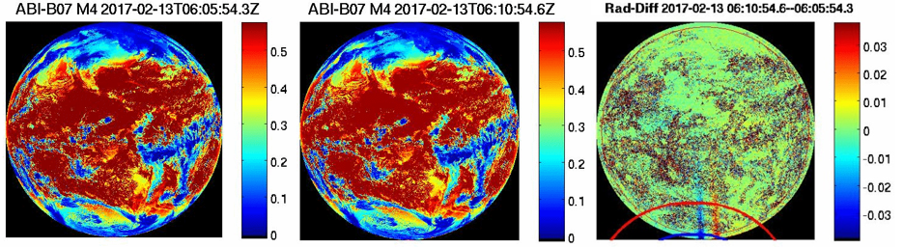
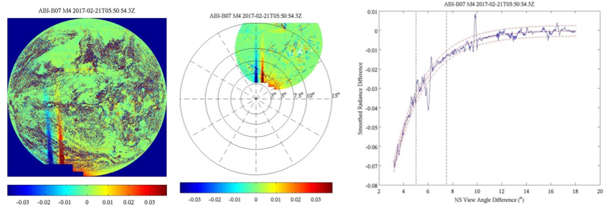
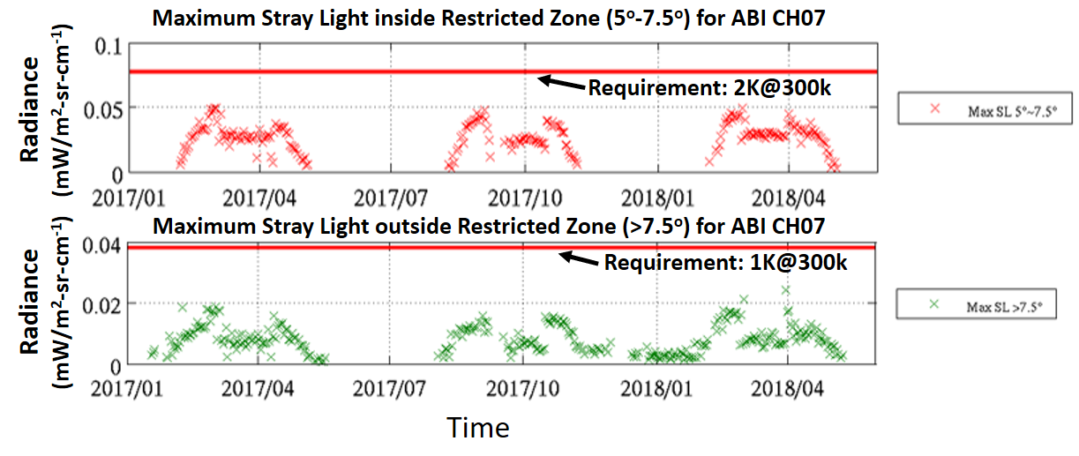
ABI-L1b-PLPT-003
ABI Restricted Zone Performance
Methodology
Objective
Quantify measurement errors that may occur in the visible and IR channels when the sun is near and within 3º - 7.5 º for ABI VINIR and 5 º - 7.5 º from the ABI line of sight for ABI B07 3.9 um channel.
Related Requirements
MRD (2120): Radiometric accuracy for ABI IR band
<2K @300K inside restricted zone
<1K @300K outside restricted zone (> 7.5º)
Steps: Difference-Radiance-Image; Coordinate Transformation; Exponential Fitting and Estimation of Maximum Stray Light
Results
Summary
Long term monitoring shows that ABI CH07 stray light inside and outside restricted zone are both within the specification
Long term monitoring of ABI VNIR channel stray light has been carried out. No requirements are violated for stray light at night side for ABI VNIR channel.
Success
Long Term Monitoring Maximum Stray Light for ABI CH07

Slide 51

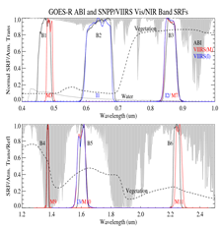
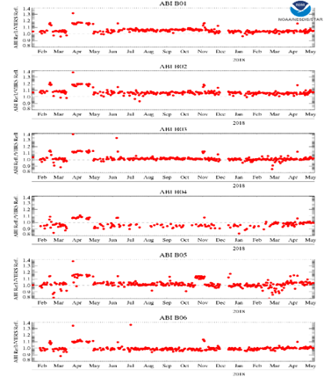
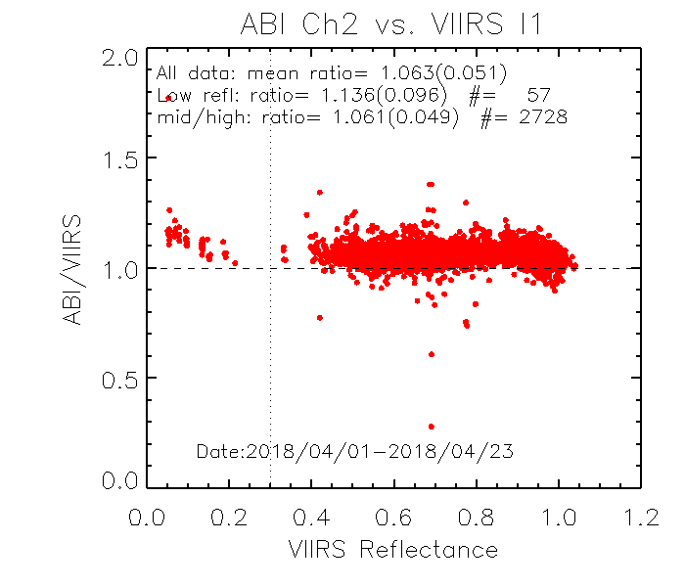
ABI-L1b-PLPT-004
Vnir validation: viirs inter-calibration
Objective
Demonstrate and quality agreement between ABI and temporally and spatially coincident SNPP VIIRS VNIR data collected at the same viewing geometry
Related Requirements
MRD 737, 2120, and 2130
Methodology
Collocated scenes for analysis
Time difference: <7.5 minutes for M3 data
Cosine of viewing zenith angle difference < 1%
Central pixel difference: <375m for B2 (0.64$µ$m) and 750m for other bands
Time: 17:00UTC-19:00UTC
Geolocation range: 2ºS < latitude < 2ºN
CoV(ENV)_{VIIRS} < 5% and CoV(FOV)_{VIIRS} < 5%
Azimuth angle difference: < 15°
SRF adjustment:
Results
Summary
064 Channel has bias of 6-7%.
Other channels agree with VIIRS within 5%.
Uncertainty of the bias estimate is less than 6%.
No significant angular dependent difference to VIIRS
No significantly different between native and down sampling spatial resolution data
No dependence on scene reflectance.
Left: Time-series of daily reflectance ratio between ABI and VIIRS. Upper: scatterplot of scene dependent ABI and VIIRS reflectance difference.
Complete

Slide 52
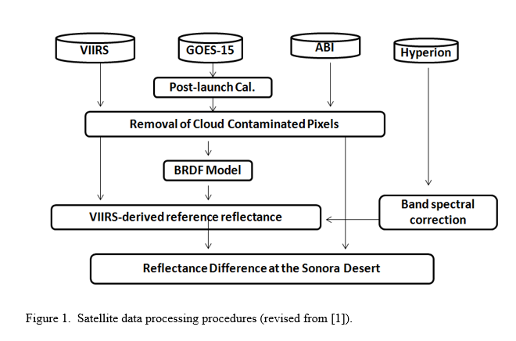
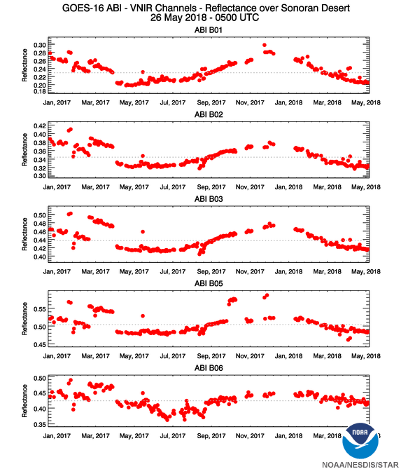
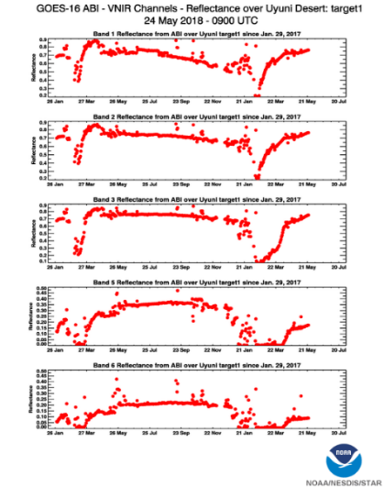
ABI-L1b-PLPT-005
VNIR validation: desert
Objective
Demonstrate ABI VNIR bands calibration stability using the desert
Related Requirements
MRD 737, 2120, 2130
Reference: Yu et al. (2014), JGR-Atmosphere, 119(14), 8639-8658.
Results
Summary
ABI data have been routinely collected at the Sonoran and Uyuni desert sites
Time-series of daily cloud-free reflectance have been used to validate the sudden calibration variation (e.g. ~10% jump)
VIIRS reflectance at the desert sites are collected and analyzed.
Reliable BRDF models are not available yet. Need >6 months of stable ABI desert measurements .
Partial Success
Time-series of daily reflectance at Sonoran (left) and Uyuni (right) deserts

Slide 53
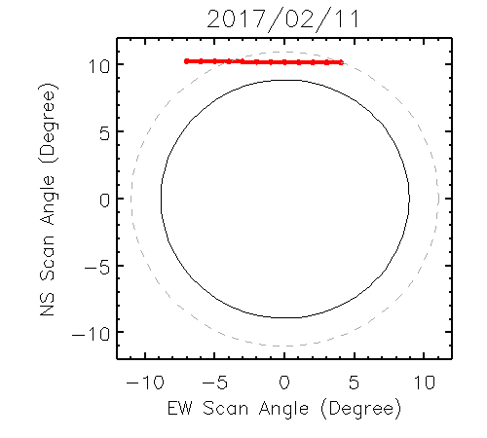
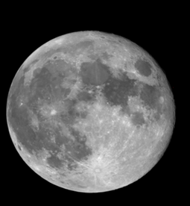
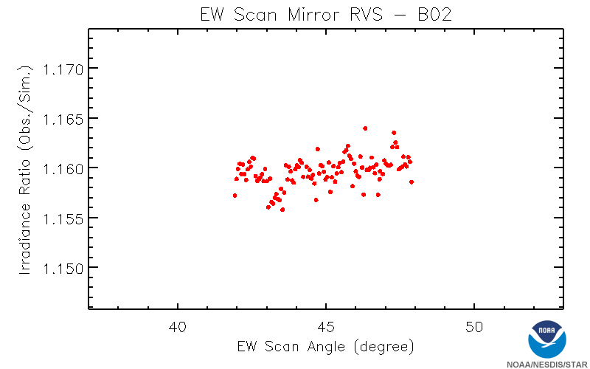
ABI-L1b-PLPT-006
VNIR Validation: Rvs
Objective
Determine and validate scan mirror angle-dependent reflectivity corrections for the VNIR bands.
Related Requirements
MRD 2120
Methodology
Use of GIRO model to compensate for lunar irradiance variation for the lunar images collected as it transited across the ABI field of regard
Results
Summary
Lunar chasing data were successfully collected beyond the Earth Poles.
Based on the data collected on 02/11/2017, variation of the ratio between the measured and simulated lunar irradiance was within 1% for all the 6 VNIR bands.
Success
Scatterplot of lunar irradiance ratio versus scan angles

Slide 54
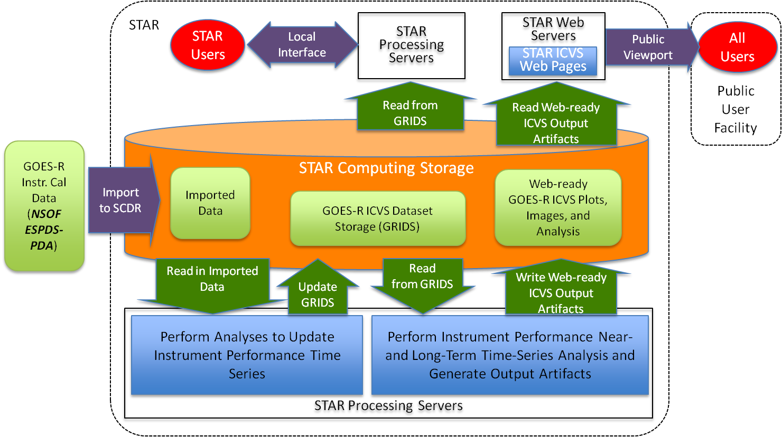
ABI-L1b-PLPT-007
Monitoring
Objective
Perform automated monitoring of ABI instrument performance in near-real time at the STAR designated GOES Calibration web site.
Related Requirements
MRD-737, MRD-2120, MRD-2121, MRD-2158, and MRD-2130
Methodology
GOES-R ABI IPM Architecture
Results
The CWG GOES-R ABI IPM results can be found at the following links:
Instrument Calibration Data https://www.star.nesdis.noaa.gov/GOESCal/G16_IPM_Ops-BothCalStats_daily.php
Solar Calibration Data https://www.star.nesdis.noaa.gov/GOESCal/G16_ABI_Solar_Cal_static.php
Engineering Data https://www.star.nesdis.noaa.gov/GOESCal/G16_IPM_EngTelemStats_daily.php
Summary
Success Criteria | Status
Monitored data are correct with respect to source INST-CAL data | Fail – Errors in engineering data captured in ADR-304 will be fixed in DO.07.00
INST-CAL data can be processed faster than the rate that they are acquired by ABI, processed by the GOES-R Ground Segment, and delivered to STAR through PDA | Pass - Software processes data at least 100X faster than total data latency
Monitored data represents at least 95% of INST-CAL data available for processing | Pass – Greater than 99% of available data are processed
Full Report:
GOES-R_ABI-L1b-PLPT-007_Report_FullValMat_15FEB2018.pptx

Slide 55
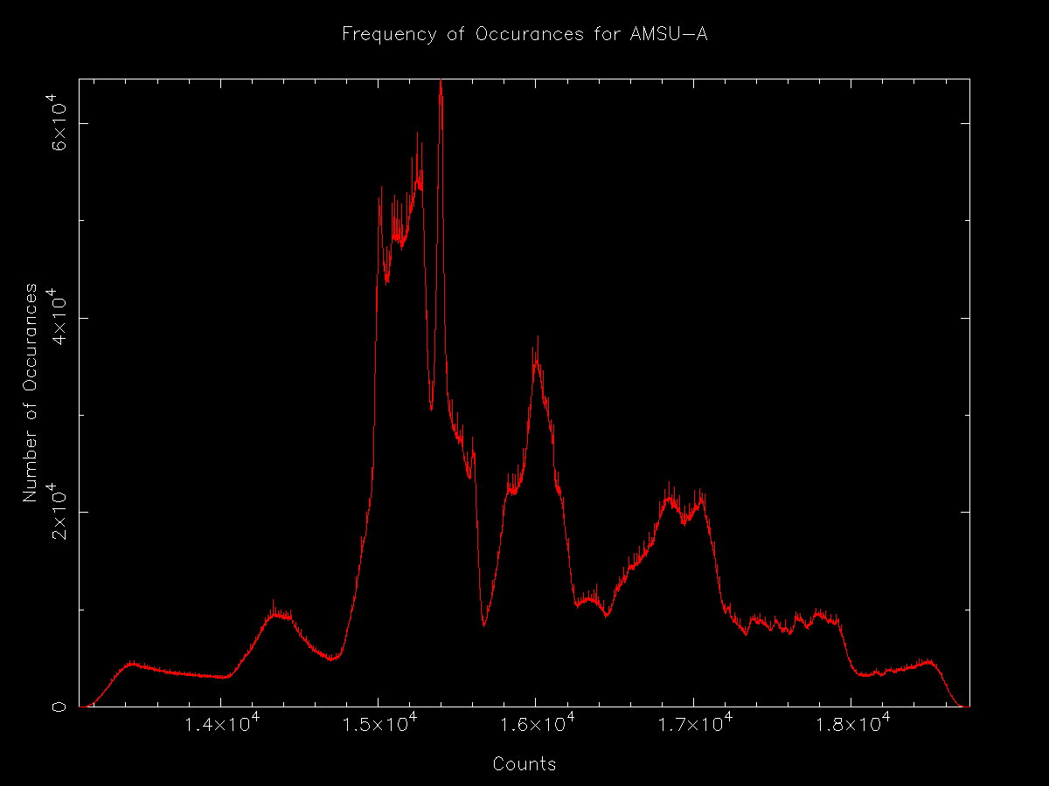



ABI-L1b-PLPT-008
A/D Converter Performance
Objective
Evaluate the performance of Analog-to-Digital Converter, in particular the abnormal distribution of histogram at the count values of multiples of 2^{n}.
Related Requirements
MRD 2158.
Methodology
zooming
Example of bit leaking for
NOAA-19 AMSU L1b data to show anomaly after zooming (top)
For ABI
Study ABI A-D converter based on ABI L1a unpacked by GRATDAT.
Using 23 swaths of FD L1a in 15min.
Statistical on count bin and inspect subjective and with tool
Results
Summary
Initial investigation with ABI L1B don’t show the anomaly.
L1a does show that the bit leaking occurs, but band-dependent.
Band1,2,5,10,12 shows clear bit leaking pattern. The bit leaking occur every 256 count bin. Other bands are complicate.
Figure 2 Example of selected bands (band01) showing the bit leaking anomalies. Non-zero count bin signal (red box) is extracted to enhance the anomaly in the right with removing the zero count bin.
Results used. Report in preparation.

Slide 56

ABI-L1b-PLPT-009
Low Light SNR
Objective
Characterize SNR at various signal levels for all ABI VNIR bands. In particular, validate the low light SNR for Band 2.
Related Requirements
MRD-2156
Methodology
Use ABI L1b Channel 2 MESO data from a Mode-3 timeline with collocated MESO-1 and MESO-2 centers.
For each of the 30 MESO scenes, compute a measure of spatial variability for each pixel
For low-light pixels with low spatial variability – i.e., mainly clear-sky homogenous ocean regions - find the temporal difference between consecutive MESO scenes
Compile results from all MESO image pairs and determine SNR statistics for five sub-intervals over the low-light albedo range.
Results
Summary
Success Criteria | Status
Low-light SNR meets User Expected Baseline Performance for ABI Band 2 at 5% reflectance by measurements or interpolation. | Pass – The test-measured Ch2 SNR at 5% albedo of 46±2 exceeds the Expected Baseline Performance minimum Ch2 SNR at 5% albedo of 44.
5% Albedo
Full Report:
GOES-R_ABI-L1b-PLPT-009_Report_FullValMat_16APR2018.pptx
G16 ABI Ch 2 SNR vs Mean Albedo

Slide 57


ABI-L1b-PLPT-010
Image Navigation
Objective
Quantify the navigation residuals of ABI window channels. Check navigation stability. Trend performance during PLPT period and support other PLPTs as needed.
Related Requirements
MRD522 (Navigation errors not during eclipse); MRD523 (Navigation errors during eclipse); MRD538 and MRD539 (Frame-to-frame registration (FFR)).
Methodology
Landmark use for the nav. error determination
Results
The CWG GOES-R ABI Image Navigation results can be found at the following links:
SLT Noon Navigation Residuals: https://www.star.nesdis.noaa.gov/GOESCal/G16_ABI_INR_daily.php
SLT Noon FFR:
https://www.star.nesdis.noaa.gov/GOESCal/G16_ABI_INR_daily.php
Daily Monitor Residuals:
https://www.star.nesdis.noaa.gov/GOESCal/G16_ABI_INR_daily.php
Daily Monitor FFR:
https://www.star.nesdis.noaa.gov/GOESCal/G16_ABI_INR_daily.php
Daily-Averaged Residuals for 2 Weeks:
https://www.star.nesdis.noaa.gov/GOESCal/G16_ABI_INR_daily.php
Daily-Averaged FFR for 2 Weeks:
https://www.star.nesdis.noaa.gov/GOESCal/G16_ABI_INR_daily.php
Summary
ABI in-frame navigation residuals meet requirements with a large margin.
ABI frame-to-frame navigation residuals meet requirements with a large margin.
Navigation residuals during eclipse meet requirements but are larger than the baseline. Recommendation: Further Kalman filter tuning, more star observations.
Success

Slide 58

ABI-L1b-PLPT-011
Image Registration
Objective
Quantify the channel-to-channel registration (CCR) of the ABI window channels. Check CCR stability. Trend performance during PLPT period and support other PLPTs as needed.
Related Requirements
MRD529 – 533 (channel-to-channel registration). No expected performance baseline results for MRD531 and MRD533.
Methodology
Method 1: compare the navigation residuals of a channel pair.
Method 2: navigate one channel with respect to another.
Results
The CWG GOES-R ABI Channel-to-Channel Registration results can be found at the following links:
SLT Noon CCR:
https://www.star.nesdis.noaa.gov/GOESCal/G16_ABI_INR_daily.php
Daily Monitor CCR:
https://www.star.nesdis.noaa.gov/GOESCal/G16_ABI_INR_daily.php
Daily-Averaged CCR for 2 Weeks:
https://www.star.nesdis.noaa.gov/GOESCal/G16_ABI_INR_daily.php
Summary
ABI in-FPA CCR residuals meet requirements with a large margin.
ABI VNIR-MWIR CCR residuals meet requirements.
ABI VNIR-LWIR CCR residuals meet requirements.
ABI MWIR-LWIR CCR residuals meet baseline but exceed the expected performance values. Recommendation: Further Kalman filter tuning, more star observations.
Success

Slide 59



ABI-L1b-PLPT-012
Image Stitching
Objective
Assess the swath-to-swath registration (SSR) and within-frame registration (WIFR) errors of the ABI window channels. Trend performance during PLPT period and support other PLPTs as needed.
Related Requirements
MRD535 (pixel-to-pixel registration error within frame (WIFR-I) – separate two navigated radiance sample); MRD536 (pixel-to-pixel registration error within frame (WIFR-II) – register two adjacent lines/swaths)
Methodology
WIFR I error of an image is measured by the STD of landmark residuals.
WIFR II error is the average SSR. Swath residual is the average of landmark residuals within a swath.
Summary
ABI WIFR-I errors are below the baseline but above the expected performance. Constant half-pixel shift between the MESO and other frames – fix is scheduled in DO07.
ABI SSR VNIR residuals meet requirements.
ABI SSR MWIR residuals exceed requirements.
ABI SSR LWIR residuals exceed requirements. Recommendation: Further Kalman filter tuning, more star observations.
Results
The CWG GOES-R ABI Swath-to-Swath Registration and WIFR results can be found at the following links:
SLT Noon Swath Residuals:
https://www.star.nesdis.noaa.gov/GOESCal/G16_ABI_INR_daily.php
Daily Monitor STD (East-West and North-South):
https://www.star.nesdis.noaa.gov/GOESCal/G16_ABI_INR_daily.php
Daily-Averaged STD for 2 weeks (East-West and North-South):
https://www.star.nesdis.noaa.gov/GOESCal/G16_ABI_INR_daily.php
Partial Success

Slide 60




ABI-L1b-PLPT-013
VNIR Validation DCC
Objective
To validate the radiance accuracy of ABI’s six visible and near infrared (VNIR) bands, using the VIIRS data as references (per Global Space-based Inter-Calibration System (GSICS) algorithm).
To provide useful information of the ABI radiometric calibration stability by monitoring DCC reflectance trending.
Related Requirements
MRD737 (Long-term radiance drift); MRD2120 (Solar calibration absolute accuracy); and MRD-2130 (Product monitoring).
Methodology
The DCC pixels are described as followings:
20°S < latitude < 20°N and 120°W< longitude < 45°W
Brightness temperature at Band 14 (11µm) < 205 K
Standard deviation at Band 14 (11µm) < 1 K
Solar zenith angle < 40° and viewing zenith angle < 40 °
Reflectance standard deviation at Band 2 (0.64µm) < 0.03
Avoid sun glint area & data quality flag ≤ 1 for ABI data
Apply for Spectral Band Adjustment Factor (SBAF) derived from
SCIAMACHY between ABI and VIIRS, Angular Distribution Model (ADM)
adjustment
i) Select VIIRS DCC pixel within 1 km distance from ABI DCC pixel
Results
Summary
DCCs reflectance from both the ABI and the VIIRS are in a good agreement in terms of pattern and shape.
ABI DCC reflectance of Bands 1, 2, 3, and 5 is brighter than VIIRS for 6 %, 6 %, 2 %, and 0.7 %, respectively but the ABI Band 6 is slightly darker than VIIRS about 0.7 %. The ABI Band 4 is similar with VIIRS.
Support the Full Validation Mission
Time series of ABI/VIIRS DCC reflectance for VNIR bands
Time series of ABI/VIIRS DCC reflectance for VNIR bands

Slide 61
ABI-L1b-PLPT-014
VNIR Detector Uniformity Stability
Objective
Verify whether ABI VNIR detector uniformity changes over time.
Related Requirements
MRD 2122.
Methodology
Perform NSS over Sonoran Desert and Uyuni Palaya on days when ABI performs scheduled solar calibration.
Collect and archive the data.
Process the data to Level 1-beta equivalent (calibrated and geo-located but not resampled) using GRATDAT.
Derive detector uniformity.
Compare with previous results.
Results
Summary
It is recommended to analyze some of these data in future:
Those collected within 1-2 weeks, when stability is expected, to establish uncertainty of the method; and
Those every 3-6 months to quantify variability of detector uniformity.
Data were collected and archived but not analyzed.
Incomplete, but non-critical

Slide 62
ABI-L1b-PLPT-015
NSS During SNO
Objective
Quantify ABI VNIR detector uniformity, and evaluate the radiometric calibration accuracy for individual detector of ABI VNIR channels.
Related Requirements
Accuracy (MRD ###).
Detector-to-detector repeatability (MRD ###).
Methodology
Perform NSS at nadir at the time of S-NPP underpass. Collect and archive the data.
Process the data to Level 1-beta equivalent (calibrated and geo-located but not resampled) using GRATDAT.
Derive detector uniformity.
Collocate the data with corresponding channel of VIIRS nadir pixel.
Evaluate radiometric calibration accuracy for individual detector.
Results
Summary
There is no need currently to analyze these data, however the data are available for analysis if the needs arise later.
Data were collected and archived but not analyzed.
Incomplete, but non-critical

Slide 63
ABI-L1b-PLPT-016
NSS for L2 Validation
Objective
Perform NSS in support for Level 2 product validation.
Related Requirements
None, but requested by Level 2 product development team leads.
Methodology
Identify with ABI Level 2 product development team leads the time, location, and channels of desired NSS
Coordinate with the GOES-R Program to acquire these data.
Results
Summary
Data were collected and archived as planned. L2 team leads appreciate the help.
Data were collected and archived as planned. More results later.
Success

Slide 64




ABI-L1b-PLPT-017
Instr. Characterization: NSS Lunar
Objective
Characterize out-of-field response, blooming, and detector-to-detector uniformity
Related Requirements
MRD519: detector-to-detector radiance with relative accuracy in each band within1-sigma noise
Methodology
ABI scans across the moon with north-south scan mode
Results
Summary
Lunar north-south scan data successfully collected.
In-house tools developed to convert the lunar NSS L1A data to L1alpha data accurately.
Out-of-field response and blooming effects are characterized with the L1alpha data
Detector-to-detector uniformity is characterized for all the channels with the CWG developed L1alpha data
Band 2
3D display of the NSS response
Success
Detector uniformity for B04

Slide 65
ABI-L1b-PLPT-018
Detector Uniformity Investigation
Objective
Investigate the root cause of detector-to-detector variability for selected ABI bands.
Related Requirements
MRD519: detector-to-detector radiance with relative accuracy in each band within1-sigma noise
Methodology
Collect NSS data over Deep Convective Clouds. This establish detector SRF effects on ICT calibration.
Collect NSS data over a variety of scenes.
Collect nearly overlapped MESO data over South America that include high and low humidity, high and low altitude, high and low reflectance, ocean and forest.
Analyze the above data to evaluate the effect of surface reflectance and atmospheric absorption on detector variability.
Results
Nearly overlapped data were not collected. Also, GRATDAT was not mature to analyze NSS data.
Summary
This test will be attempted again for GOES-17.
Incomplete.

Slide 66

ABI-L1b-PLPT-019
Initial Solar Calibration
Objective
Establish the baseline of calibration based on solar calibration target (SCT, also referred to as solar diffuser SD) for ABI visible and near infrared (VNIR) bands.
Related Requirements
MRD519: detector-to-detector radiance with relative accuracy in each band within1-sigma noise
Methodology
Analyze the special data collected during the first 20 days of mission.
Compare with pre-launch test data and post-launch validation data.
Method has to be revised because solar calibration were not performed at the designated time.
Special solar calibration data were collected one year later at the same beta and elevation angle.
Results
Following is an example of using the data and CWG code to verify GS results.
Summary
Revised method alleviated the difficulties due to incorrect collection of solar calibration data.
But it also delay the test substantially.
Results have been used to evaluate ABI performance.
Lessons learned have been applied to GOES-17.
Test report will be completed.
Results have been used.

Slide 67


ABI-L1b-PLPT-020
IR Spatial uniformity
Objective
Verify spatial uniformity for the ABI IR bands
Related Requirements
MRD 737, 1493, 1503, 1513
Methodology
Time-series of space MESO images conducted above or below the Earth Poles to investigate root cause to PICA and verify the spatial uniformity after the scan mirror emissivity LUT updates.
GEO-LEO IR inter-calibration at diurnal and geolocation variations to validate spatial uniformity of the Earth scenes
Results
Summary
Identified the root cause to the Periodic Infrared Calibration Anomaly (PICA).
PICA anomaly significantly reduced with the update of the SM emissivity LUTs on 10/19/2017.
Both L1alpha space and Earth scene L1B data showed improved spatial uniformity with the update of SM emissivity LUTs
Left: time-series of mean space radiance before and after the SM emissivity LUT update for the PICA correction. Upper-right: time-series of GEO-LEO IR Tb bias showing the reduced diurnal variation after the LUT updates. Lower-right: longitude dependent Tb bias before and after the LUT updates
Success

Slide 68


ABI-L1b-PLPT-021
Spectral response function (SRF)
Objective
Evaluate ABI SRF for IR bands
Related Requirements
MRD506, 1493, 1503, 1513, 2120, 2130
Methodology
References
- X. Wu and F. Yu, 2013, TGRS, 51(3), 1215-1223.
- Yu, F. and X. Wu, 2013, TGRS, 51(3). 1200-1214.
Results
Summary
All the IR bands have negative bias to CrIS/IASI within less than 0.3K.
These slight cold biases may be mainly due to the erroneous blackbody PRT temperature
GOES16 ABI IR SRF are generally well characterized on-ground.
Further analysis of sounding channel SRFs may be conducted after the PRT temperature correction.
Success
Mean Tb bias to CrIS (in red) and IASI (in blue)

Slide 69




ABI-L1b-PLPT-022
Out-Of-Band Response
Objective
Assess ABI out-of-band (OOB) response for IR bands
Related Requirements
MRD 1493, 1503, 1513, 2120, 2130
Methodology
- Examine the differences of spatially integrated ABI measurements and spectrally integrated IASI measurements as a function of selected wavelength as obtained from concurrent IASI measurements. The two should not be correlated in the absence of OOB.
- Examine the lunar NSS data. OOB, if exists, cab be validated with extra radiance when it scans space.
Results
Summary
For a given IR band, no significant relationship can be found between its Tb bias to IASI and any other IR bands
Several bands show relatively larger correlations with the neighbor band in the FPM.
These slight OOB energy can be observed with the lunar NSS data
Correlation between B16 and IASI Tb difference versus all the other IR bands
Success
6/1/2018

Slide 70
ABI-L1b-PLPT-023
Polarization
Objective
Characterize the linear polarization state of radiation.
Related Requirements
None, but requested by Level 2 product development team leads.
Methodology
Measure the polarized spectral radiance near surface during the field campaign.
Use that as inputs to a radiative transfer model to compute the polarized spectral radiance at the top of the atmosphere.
Use these TOA polarized spectral radiance to estimate the impact of ABI polarization sensitivity on its measurements, esp. the 047 Channel.
Results
Summary
This test is experimental in nature and relevant mostly to certain L2 product development. Will continue seeking opportunity to evaluate polarization as resource permitting.
Insufficient data were collected before the UAV crashed.
Incomplete with negligible impact

Slide 71


ABI-L1b-PLPT-024
Cal-to-Cal Repeatability
Objective
Assess the calibration-to-calibration repeatability for ABI.
Related Requirements
MRD519 (relative accuracy of radiance product).
Methodology
Track the gain change between consecutive ICT calibration and concerts it into temperature variation
gain variation and cal-to-cal repeatability
Results
Summary
The cal-to-cal repeatability is significantly less than the relative accuracy requirement of the product.
The long-term drift of the cal-to-cal repeatability is negligibly small, as well as its diurnal and seasonal variation.
The assessment only covers normal repeatability, not gain jump due to various reasons (level-shift, detector saturation, etc.)
Success
Calibration-to-Calibration Stability

Slide 72





ABI-L1b-PLPT-025
LINEARITY
Objective
Validate the system linearity for selected channels of ABI.
Related Requirements
MRD Table 3.4.8.1.2 (ABI performance summary).
Methodology
Reanalyze the data of ECAL executed for PLT.
Band 2 ECAL Analysis
Results
Summary
The system requirement of linearity is met for all bands.
The reanalysis of the PLT data indicates better linearity than the pre-launch and PLT results.
Limited by the data availability, the results are not a comprehensive measure of system linearity.
Success
ABI System Linearity

Slide 73








ABI-L1b-PLPT-026
Ghosting
Objective
Analysis of lunar NSS for the out-of-field and blooming effect.
Related Requirements
None MRD, but characterization necessary for full characterization of L1B products
Methodology
Band 1
Band 6
Results
Summary
Characterized the out-of-field and blooming effect for each detector of the bands
The OOF and blooming effects are very small for all the detectors.
For the VNIR bands, B1/2/3 have less samples impacted with OOF and blooming than B4/5/6
Some B6 detectors was affected with low straylight away from the Moon. This straylight can be shown with normal lunar scan image
Band 6
Band 1

Slide 74


ABI-L1b-PLPT-027
Airborne Field Campaign (VNIR Validation with AVIRIS-NG)
Methodology
Objective
Validate ABI L1b radiance accuracy with SI-traceable measurements from aircraft (ER-2) under flights.
Related Requirements
MRD (2120): Radiometric accuracy for ABI VNIR channel (< 5%)
Results
Summary
Independent studies of comparing ABI MESO and NSS data with AVIRSIS-NG by two teams (Padula et al. and CWG/STAR) show consistent results.
Successful GOES-16 ABI field campaign with AVIRIS-NG coordinated by Padula et al. in Mar.-May, 2017.
Validated radiometric accuracies of ABI CH01, CH03, CH05 and CH06 are all within 5%
ABI CH02 radiometric accuracy is ~6-7%
Mitigation plan for ABI CH02 bias correction has been proposed
Success

Slide 75


ABI-L1b-PLPT-027
Airborne Field Campaign (TEB Validation with AVIRIS-NG)
Methodology
Objective
Validate ABI L1b radiance accuracy with SI-traceable measurements from aircraft (ER-2) under flights.
Related Requirements
MRD (2120): Radiometric accuracy for ABI TEB (<1K @300K scene)
MESO and NSS data over ocean and land were both used for radiometric validation of ABI TEB
Independent validation by three teams (J. Taylor, Padula et al. and CWG/STAR)
Results
Summary
Successful airborne field campaign with S-HIS (J. Taylor) coordinated by Padula et al. in Mar.-May, 2017.
Radiometric accuracies of ABI CH07-CH11 and CH13-CH15 are all <1K @ 300K scene and meet the specs.
Radiometric accuracies of ABI CH12 and CH16 have larger bias due to ozone and CO₂ absorption above ER-2.
Success

Slide 76




ABI-L1b-PLPT-028
FIELD Campaign: Surf. Instr. Deployment
Objective
Validate the SI-traceability of ABI L1b spectral radiance observation (solar bands, except 1.38µm channel) using the Earth’s surface as a reference via surface and atmospheric geophysical measurements and radiometric transfer modeling
Related Requirements
MRD 2120
Methodology
Top-of-atmosphere reflectance validation based on surface reflectance and atmospheric characterization
  NOAA – Red Lake Desert, Arizona, April 2017
  NASA – Red Lake, April 2017
  NASA – Salar de Uyuni, Bolivia, June 2017
UAS surface reflectance measurements (large area and goniometric collection) in operational environment: Red Lake, April 2017
Red Lake (April 2017)
Uyuni – ASD (June 2017)
Red Lake –UAS
(April 2017)
Results
Summary
NASA surface reflectance and atmospheric measurements at Salar Uyuni, showed good agreement with ABI at Ch1/3/5/6 within ~2%. Ch2 is brighter by ~5%.
Weather at Red Lake desert (clouds and wind) prevented high quality surface measurements.
NOAA ASD measurements have larger difference from NASA ASD and ABI measurements at Red Lake, most likely due to the larger uncertainty in the NOAA ASD reference measurements.
No UAS reference data collected due to power issues: Follow-on effort underway with reliable UAS platform with integrated advanced spectroradiometer.
TOA Reflectance difference relative to NASA results at Salar de Uyuni, Bolivia
based on 5 days of surface reflectance and atmospheric measurements. Error bars are +-1-standard deviation of the mean.
Success

Slide 77


ABI-L1b-PLPT-029
Rayleigh Scattering Calibration
Objective
Using the Rayleigh scattering calibration method, find relative and absolute calibration and trending of ABI Band 1; and relative and absolute calibration and trending of ABI Band 2.
Related Requirements
MRD-737, MRD-2120 and MRD-2130
Methodology
Applied the Vermote (1992) method to ABI
Calibration targets are determined from a climatology developed by Fougnie (2002) - targets include portions of Scene-0 South East Pacific Ocean, Scene-3 North Atlantic Ocean, and Scene-8 Costa Rica Dome.
Scene solar and satellite geometry filter settings adopted from Fougnie and Henri (2009).
The NASA 6SV 1.0 Beta version is used to simulate and compare to ABI Band 1 and 2 top-of-atmosphere radiances.
Results
Summary
Success Criteria | Status
Relative and absolute calibration and trending of ABI Band 1; and relative and absolute calibration and trending of ABI Band 2. | Not Conclusive - Uncertainty of climatological mean aerosol optical depth (AOD) can lead to uncertainties and/or biases of up to 12% and 34% for Ch 1 and Ch 2 results, respectively. Method needs more accurate AOD inputs to determine relative and absolute calibration and trending.
ABI Ch 1 Obs/Sim Albedo versus Date for Pacific SE
ABI Ch 2 Obs/Sim Albedo versus Date for Pacific SE
Full Report:
GOES-R_ABI-L1b-PLPT-029_Report_FullValMat_24FEB2018.pptx

Slide 78


ABI-L1b-PLPT-030
VNIR Validation Uyuni desert
Methodology
Objective
To monitor any changes in the solar calibration with the day-by-day cloud-free desert reflectance.
To validate the accuracy of ABI Channels 1, 2, 3, 5, and 6 using Uyuni Desert as reference.
Related Requirements
MRD737 (Long-term radiance drift); MRD2120 (Solar calibration absolute accuracy); and MRD-2130 (Product monitoring).
Select region of interest (ROI)
Radiometric and temporal stability with GOES-East Imager visible
data
Apply the post-launch calibration using calibration coefficients
Identify the areas with low standard deviation and NDVI values
Spatial stability with SNPP VIIRS SDR data
Identify the areas with low covariance pixels and NDVI values
Two geophysical locations of the uniform areas:
the green: Target 1 (20.20°-20.05°S, 67.65°-67.50°W),
the blue: Target 2 (20.38°-20.23°S, 67.35°-67.20°W).
Results
Summary
Uyuni desert is a stable target during April – October but reflectance is very low during wintertime due to precipitation.
Desert reflectance observed from the ABI five VNIR Channels is reasonably accurate compared with the VIIRS results.
Less uncertainty in the bidirectional reflectance distribution function effect is seen.
Time series of reflectance variations over the two targets from the ABI and VIIRS for five VNIR channels
Support the Full Validation Mission

Slide 79


ABI-L1b-PLPT-031
BDS
Objective
Identify (and quantify where possible) the advantages and disadvantages of ABI operating in column mode as compare with the “Best Detector Select” (BDS) model.
Related Requirements
MRD Table 3.4.8.1.2 (ABI performance summary).
Methodology
CWG documents the on-orbit BDS update, monitored the effects of BDS update and analyzed level-shift related calibration artifacts..
Detector Saturation & Level Shift
Results
Summary
The BDS update history has been documented.
The effectiveness of the BDS update is assessed with l1b image observation, mostly through the reduction of striping.
The calibration artifacts related to level-shift, lunar avoidance threshold and detector saturation are better understood.
Event No. | Band/Detector No. | From Column | To Column | Time
1 | B10D312 | 4 | 2 | 2017-10-03 18:17:00Z
2 | B12D257 | 5 | 2 | 2017-10-03 18:17:00Z
3 | B12D290 | 2 | 4 | 2018-01-02 21:00:00Z
4 | B12D291 | 2 | 6 | 2018-01-02 21:00:00Z
5 | B12D309 | 6 | 3 | 2018-03-05 15:00:00Z
6 | B10D294 | 6 | 4 | 2018-05-22 16:28:00Z
Success
BDS Update History

Slide 80


ABI-L1b-PLPT-032
ABI VNIR Signal to Noise Ratio and Dynamic Range
Objective
Determine the ABI visible and near infrared (VNIR) channels’ signal-to-noise ratio (SNR) and Dynamic Range at the beginning-of-life (BOL).
Related Requirements
MRD737 (Long-term radiance drift);
MRD1493/MRD1503 MRD1513(Product Measurement Accuracy);
MRD2120(solar reflective channels to within an absolute accuracy of 5%)
Methodology
Equations to calculate SNR and DNR
(1)
$$DNR=\left(2^{bits}− \overline{dnspc}\right)∗M$$
(2)
Where SNR is the VNIR band signal-noise-ratio, dn is the dynamic range for the detector dn is digital count; subscript SCT and SPC denote Solar Calibration Target (a solar diffuser) and space, respectively; the overhead bar denotes average; σ² is variance; DNR is the dynamic range for the detector, M the band gain.
Results
Link for SNR monitoring:
https://www.star.nesdis.noaa.gov/GOESCal/G16_ABI_Solar_Cal_static.php
Summary
CWG has verified post-launch performance with pre-launch test, and requirement of ABI VNIR SNR/DNR.
All bands pass the SNR requirement at mean condition. At worst condition, SNR of other bands are nearly above the requirement, except that band02 is slightly below the requirement.
Overall, all bands pass the DNR requirement during both provisional and full validation stages. At detector level, all detectors meets the requirements.
GOES-16 ABI VNIR SNR mean, stdv, max, min by CWG
Success

Slide 81



ABI-L1b-PLPT-033
IR CALIBRATION STABILITY
Objective
Evaluate the detector-to-detector, swath-to-swath, channel-to-channel radiometric calibration stability for ABI IR channels.
Related Requirements
MRD519 (relative accuracy of radiance product).
Methodology
Reanalyze the special scan data executed for PLT and validate the PLT results.
Results
Summary
Detector-to-detector repeatability meets the specification of requirement.
Swath-to-swatch repeatability meets the specification of requirement.
Channel-to-channel repeatability meets the specification of requirement.
There is no indication of serious on-orbit degradation of the repeatability.
Success
PLT Repeatability Reanalysis Results

Slide 82




ABI-L1b-PLPT-034
Spatial Resolution (MTF) Evaluation of ABI
Methodology
E/W Rising MTF of ABI CH02
Objective
Evaluate the ABI spatial resolution in terms of Modulation Transfer Function (MTF). Report post-launch E/W and N/S rising/falling MTF and comparison with MRD requirements and pre-launch MTF values
Related Requirements
MRD527: Spatial resolution (MTF)
Lunar NSS Data on Apr. 7, 2017
E/W Rising MTF of ABI CH13
E/W rising/falling MTF calculated with ABI MESO scan of Moon
N/S rising/falling MTF calculated with ABI NSS of Moon
Results
Summary
Successful evaluation of ABI spatial resolution with lunar MTF
E/W rising and falling MTFs of ABI VNIR and IR channels all meet the requirement
ABI CH01-Ch12 N/S rising MTFs and ABI CH01-CH06 falling MTFs meet the requirement
ABI CH13-16 N/S Rising/Falling MTF performance degrades due to transition slope in space from NSS data.
Success for ABI E/W Rising/Falling MTF

Slide 83



ABI-L1b-PLPT-034
Spatial Resolution (MTF) Evaluation of ABI

Slide 84


ABI-L1b-PLPT-035
COHERENT NOISE
Objective
Evaluate the coherent noise for ABI.
Related Requirements
MRD 506 (radiometric sensitivity and dynamic range).
Methodology
Perform Fourier transform to cropped l1b images of 2017 & 2018. Compare the Fourier series coefficients with spec. to check exceedance and on-orbit change.
FFT
Cropped Band 4 Night Time Image and Its Fourier Spectrum
Results
Summary
The coherent noise magnitude is within the system specification of requirement.
The coherent noise level has been basically stable. There is no noticeable temporal variation.
The source of the coherent noise is better understood.
For bands 2 and 5, their coherent noise is detectable from l1b image.
*: units - W/m²/sr/μm
Band No. | FFT Max* (2017) | FFT Max (2018) | FFT Max. in SI (2017) | FFT Max. in SI (2018)
1 | 0.0005 | 0.0045 | 0.0006 | 0.0056
2 | 0.2047 | 0.2712 | 1.2907 | 1.7098
3 | 0.0154 | 0.0143 | 0.0407 | 0.0379
4 | 0.0033 | 0.0038 | 0.0461 | 0.0534
5 | 0.0103 | 0.0094 | 0.1078 | 0.0982
6 | 0.0002 | 0.0004 | 0.0082 | 0.0139
Success
Coherent Noise Characterization Results

Slide 85



ABI-L1b-PLPT-036
IR SNR AND DYNAMIC RANGE
Objective
Determine the SNR (NEdT) and dynamic range of ABI IR channels at the beginning-of-life (BOL)
Related Requirements
MRD 506 (radiometric sensitivity and dynamic range).
Methodology
Independently validate the NEdT calculation of GS and evaluate IR SNR using NEdT saved in INST-CAL.
Calculate the saturation radiance/temperature by
$$L_{max}=M\left(2^{12}−1−x_{spacelook,max}\right)$$
$$T_{max}=planck\left(L_{max}\right)$$
X_{spacelook} and T_{max}
Results
Summary
The NEdT and dynamic range requirements have been met and stable since provisional review.
There is no noticeable long-term drift of the cal-to-cal repeatability is negligibly small, as well as its diurnal and seasonal variation.
ECAL and lunar data are also used to evaluate the dynamic range of some bands.
Success
IR Dynamic Range

Slide 86
Presentation Outline
Introduction
ABI L1b Product Performance
Post-Launch Product Test (PLPT)
Progress Since Provisional Review
Assessment of Maturity
Summary and Recommendations

Slide 87
Overview
Status at Provisional
Disposition of issues identified in Provisional ReadMe
Calibration anomalies resolved
Calibration anomalies being resolved
Open Algorithm Discrepancy Report (ADR)
Assessment of current status

Slide 88
Overview
Status at Provisional
Disposition of issues identified in Provisional ReadMe
Calibration anomalies resolved
Calibration anomalies being resolved
Open Algorithm Discrepancy Report (ADR)
Assessment of current status

Slide 89
Status at Provisional Maturity
 | Past Performance | Current Status | Future Outlook
IR Calibration | Accurate and stable. Acceptable noise, dynamic range, bias, and diurnal stability from beginning. Critical issues: None. | Performance has been good and stable without critical issues. Major remaining issues: PICA Midnight (space look shift?) | Good start Lack of hands-on experience, due to lack of INST-ENG data.
VNIR Calibration | Accurate, but unstable Critical issues: Initial bias Banding and striping 10% bias | Critical issues have been resolved. Overall performance acceptable. B02 bias well known. Major remaining issues: B02 differs from prelaunch ~7% B02 jumped ~4% Striping (nonlinearity?) Decouple solar cal and update | Team expertise. Good understanding of major issues. Good instrument. Need to work on some hard core problems that may require algorithm change
INR | Often inaccurate and unstable. Good first light navigation – good foundation without Kalman filter. Kalman filter works under favorable conditions. Critical issues: Ingest of star data, esp. IR Continuity of coregistration files Gyro spike RDP | Critical issues have been resolved. Recent performance becomes acceptable. Major remaining issues: Stability Large NS navigation accuracy (update RDP). CCR (Channel-to-Channel Registration) | Team expertise. Concept of KF-based INR strategy has been demonstrated. Good understanding of major issues. Corrections are in various stages of implementation in GS. This has been expected as the difficult problem.

Slide 90
Overview
Status at Provisional
Disposition of issues identified in Provisional ReadMe
Calibration anomalies resolved
Calibration anomalies being resolved
Open Algorithm Discrepancy Report (ADR)
Assessment of current status

Slide 91
Issues at Provisional – Resolved
Following issues have been resolved with INR improvement:
  Large errors in navigation.
  Non-compliance of CCR.
  Unstable FFR.
Following issues have been resolved with scan mirror emissivity update
  Periodic IR Calibration Anomaly (PICA).
  IR measurements discontinuity around satellite noon and midnight.
Solar calibration time has been optimized, eliminating the discontinuity in VNIR gain following solar calibration.

Slide 92
Issues at Provisional – Reminded
Excessive stray light for VNIR channels around satellite midnight during the eclipse season.
  Users’ needs for VNIR bands nighttime stray light rejection were not captured in requirements.
  CWG has documented the phenomenon.
  CWG will try to help with these needs in due time
Residual stray light for the 3.9μm Channel around satellite midnight during the eclipse season.
  Certain applications appear to need more stringent stray light rejection that was not captured in requirements.
CWG will continue to remind users of these aspects of ABI L1b product performance.

Slide 93
Issues at Provisional – Remained
Image striping is widespread for many channels and can be significant.
  Resolved for B01-B03. Investigation is in process for B14. Will address later.
Channel 2 may be ~7% brighter than commonly accepted values.
  Mitigation is in process. Will address later.

Slide 94
Overview
Status at Provisional
Disposition of issues identified in Provisional ReadMe
Calibration anomalies resolved
Calibration anomalies being resolved
Open Algorithm Discrepancy Report (ADR)
Assessment of current status

Slide 95




PICA – Periodic Infrared Calibration Anomaly
PICA is the anomaly with 15-minute of periodicity observed at GOES-16 ABI Mode-3 MESO and CONUS images.
Investigation of the space MESO images from the lunar chasing events revealed root cause was due to the residuals of incident-angular scan-mirror emissivity corrections
Update the scan-mirror emissivity look-up-tables (LUTs) on 10/19/2017 greatly reduced the PICA impact, improved the IR spatial uniformity, reduced the diurnal calibration variations, and ensured more consistent GEO-LEO inter-calibration results to CrIS and IASI.
PICA impact. Courtesy of C. Gravelle via D. Lindsey
Reduced PICA impact after GS update
Improved spatial uniformity
More consistent GEO-LEO Tb biases
Reduced diurnal variation

Slide 96


B01-03 Striping
Striping was observed at GOES-16 ABI VNIR bands, especially at B01/02/03 since PLT period
  CWG reported discrepancy of Q-scaling scheme between the operational calibration algorithm and the Equation described in radiometric calibration ATBD in Sept. 2017
  Vendor believed silicon detector response may also get changed in-orbit (e.g. ~4% jump of B02 in mid-March 2017)
    New Q values derived iteratively with in-orbit Earth data for B01-B03 using Q-scaling algorithm
The new Q values for B01/02/03 and “Q-scaling” scheme for all the six VNIR bands were implemented completely on 02/07/2018.
  VNIR B01/02/03 striping significantly reduced
  B04 experienced ~3% reduce in the radiance while change in the other channels was less than 1.5%
GOES-16 ABI B02 images obtained at 11:00Z (left) and 11:25Z (right) on 7 February 2018. (image provided by T. Schmit) showing the reduction in image striping after the complete implementations of the striping reduction parameters and algorithms at 11:16Z
Mean radiance difference estimated for the Earth scenes before and after the operational algorithm update

Slide 97


Solar Calibration Timing
SD reflectance varies bi-directionally.
Pre-launch, it was known for one elevation angle (0°) and variety of beta angle (-±23.5°).
Solar calibration should occur when elevation angle is zero.
In 2017, solar cal often occurred at the fixed clock time with varying elevation angle.
Negative impact on solar calibration
Fixed since Dec 2017.

Slide 98
Comments
Anomalies resolved before Provisional were often due to operational errors
  Reversed order of LUT;
  Incorrect Integration Time Multiplier;
  Outdated files after CBU switch; etc.
Anomalies resolved after Provisional require comprehensive understanding of ABI instrument calibration, ingenuous analysis, and deep dive into the data.
  Will continue into future.

Slide 99
Overview
Status at Provisional
Disposition of issues identified in Provisional ReadMe
Calibration anomalies resolved
Calibration anomalies being resolved
Open Algorithm Discrepancy Report (ADR)
Assessment of current status

Slide 100


Latched Detector Response
ABI IR detectors may experience sudden change in response – detector level shift
The level shift, if greater than lunar rejection threshold, can set the space look of this detector “latched”. Striping thus occurs
  Erroneous calibration coefficient
Striping is removed or reduced:
  If response (space look and ICT counts) is not saturated, striping is removed by resetting the space look statistics object.
  If response is saturated, space look reset can trigger “band-aid” algorithm to reduce apparent striping till the BDS is updated.
    Ongoing effort for the current operational algorithm to protect from the saturated ICT
Actual detector responses
Detector level shift
“Latched” space look used for operational calibration

Slide 101


11.2μm Striping
Horizontal striping has been detected for the 11.2μm band and, less frequently, for some other IR bands.
For the 11.2μm band, the most obvious striping is linked to 3 detectors with non-zero Q. The same correlation is discovered for bands 15 & 16.
The striping patterns also suggest that the Q LUT of these detectors are probably problematic.
There is an on-going effort by CWG to determine the root cause.
repeat each swath
D307
D250
D176

Slide 102


ICT PRT Coefficients
In April 2018, a possible discrepancy between the ICT PRT coefficients saved in Flight CDRL-42 and GS LUT was discovered and later confirmed.
The implementation of the correct CDRL 42 coefficients shall shrink the spread of the 12 ICT PRT temperatures from ~ 6 K to < 0.1 K. The reported average ICT temperature for gain calculation shall increase by 0.2 K.
The update of GS LUT is expected to remove at least the majority of ~ -0.2 K bias observed for all IR bands.
PRT Coeff. from GS LUT

PRT Coeff. from CDRL 42

Slide 103


Cold Pixels Around Fire (CPAF)
Compare 390um channel with a longwave IR channel such as 112um for a fire scene, the fire can be much hotter in 390 band than 112 band (412K or saturated vs. 302K).
Nearby pixels can be much colder in 390 band than 112 band (0K or saturated vs. 287K).
Both phenomena are well understood.
Flag has been implemented in operation, and works well, to avoid confusion.
User requested enhancement, which seems within reach.
Several options have been considered. One was chosen. Work is underway.

Slide 104
064 Band Bias
064 Channel is more than 5% brighter than pre-launch, VIIRS, and AVIRIS-NG (Field Campaign).
It is likely caused by uncertainty in the K factor, the detector- and angle-dependent reflectance of solar diffuser that was determined pre-launch.
There is no consensus whether K is wrong and, if it is, what is the right value for K.
There is consensus that the calibrated radiance is wrong and users demand quick change.
It is recommended to adjust K to bring 064 radiance to be in family.

Slide 105

ABI CH02 Bias and Mitigation
ABI CH02 showed 6-8% large radiometric biases immediately after first solar calibration which violated the MRD radiometric requirement
ABI CH02 bias has been confirmed with the long term GEO-LEO (VIIRS) bias monitoring and field campaign comparison with AVIRIS-NG
One important fact
  ABI CH02 prelaunch gain is lower than post-launch Solar Cal gain by 6.5%
Pre-launch Sphere and FEL tests are two separate calibration tests
  Sphere test is used to derive prelaunch gain and Q for detectors of each ABI VNIR bands (SI-traceable)
  FEL test is to derive the K factor (proportional to SD BRDF) which is used in post-launch calibration
Post-launch gain factor from Solar Cal can only be traced to the prelaunch FEL test
This leads to the investigation of uncertainty in the prelaunch FEL test
Post-launch Solar Cal Gain
Prelaunch gain

Slide 106
Evidence of Uncertainty in ABI PRE-LAUNCH FEL TEST for ABI CH02
FEL test signal is significantly weak
  Large space look signal (~ 3460 counts) with uncertainty of 11 counts (ABI CH02 has the largest uncertainty)
  FEL lamp signal for ABI CH02 is ~130 counts (~21 W/m²-sr-um). (much weaker than space look and can be affected by the large uncertainty in space look)
Sphere Test for prelaunch gain and Q for ABI CH02
  Signal level varies from 15 to 1929 W/m²-sr-um over 24 levels (much higher than FEL lamp)
Post-launch Solar Cal signal is around 4100 counts after subtracting space look.
Other uncertainties
  FEL test has ~ 7 counts stray light (ABI CH02 is the highest)
  Solar diffuser K factor can be affected by the stray light correction model
  FEL lamp non-uniformity characterization
Further evidence
  ABI CH02 solar diffuser K factor is higher than all other bands (inconsistent with the reflectance property of solar diffuser material )

Slide 107
Mitigation Plan for ABI CH02 BIAS
Multiple independent evaluation confirmed the bias for ABI CH02.
Root cause for radiometric bias of ABI CH02 needs further investigation
Immediate Mitigation Plan
  Use pre-launch and post-launch gain ratio to normalize K factor and peg the shape of K factor w.r.t. detector from FEL test (~6.5% reduction)
Detector uniformity improvement and accounting for solar diffuser degradation
  The detector K factor will be optimized with the lunar and earth surface NSS data to minimize the striping/banding effects due to the change in algorithm.

Slide 108



Strong Refracted Solar Light Leaking onto ABI Detector in March, 2018
At night side, strong solar light leaked onto ABI detectors when Sun is behind Earth due to refraction of solar light propagating through the atmosphere
Occurred frequently when the sun is near the limb margin in March, 2018
Caused the ABI VNIR detectors to saturate. Harmful for ABI detectors.
ABI solar avoidance truncation was confirmed to perform correctly with the limb margin set at 8.1 degree
It was concluded that the swath truncation is not adequate with the current limb margin at 8.1 degree
Proposed adjustment of limb margin radius to 7.9 degree or lower to avoid the strong leaking light.
The MODTRAN 2/3 Report and LOWTRAN 7 MODEL

Slide 109






Proposed Solar Avoidance Parameter to Avoid Strong Refracted Solar Light Leaking onto ABI Detector
Mar. 2, 2018, ABI CH03
Mar. 3, 2018, ABI CH03
Mar. 19, 2018, ABI CH07
Current Swath Truncation with Limb Margin at 8.1 Degree
Missed
Missed
Missed
Proposed Swath Truncation with Limb Margin at 7.9 Degree
The proposed change of the limb margin radius to 7.9 degree for solar avoidance truncation can effectively avoid the strong leaking solar light onto the ABI detectors

Slide 110
Overview
Status at Provisional
Disposition of issues identified in Provisional ReadMe
Calibration anomalies resolved
Calibration anomalies being resolved
Open Algorithm Discrepancy Report (ADR)
Assessment of current status

Slide 111
High Priority ADRs
ADR | WR | Title | DO Build | Impact to Product Val Effort
254 |  | Positive Radiance Bias (9%) in ABI B02 | Hold | Anomalous imagery and Level 2+ Products
504 |  | Transient Navigation Anomalies of GOES-16 ABI | Hold | Anomalous and unreliable INR can be a show-stopper for GOES-R products.
304 | 4345 | DO.04.04 ABI INST-CAL-ENG Data Show Irregularities | DO.07 | Stops ABI Instrument calibration assessment and Instrument Performance Monitoring.

Slide 112
Moderate Priority ADRs
ADR | WR | Title | DO Build | Impact to Product Val Effort
573 |  | Update Kalman and Star Detection LUT parameters | PRO Release T1 | Bad Kalman LUT = Bad ABI INR
516 | 5799 | ABI Band05 has striping recently | TBD | Striping creates ABI image artifacts
537 | 5522 | ABI L1b LUT updates for end of drift | DO.07 | E-W INR Bias
667 |  | GOES-17 ABI L1b CWG Values Update | PRO Release T1
300 | 3888 | Large Navigation Error in ABI Meso Scan | DO.08 | Anomalous L2+ products. Unpleasant experience for users.
275 | 4187 | Anomalous EW navigation biases | Fix In Validation | Minimal. Needed for the full understanding and verification of GS navigation algorithm
503 | 5642 | ABI cold pixels near bright scenes | TBD | Bad L1b data around fire pixels can cause erroneous L2+ product output
594 |  | ABI Lunar Intrusion Level Latchup: Longer Term Fix | TBD | During spacelook latch-up, unacceptable striping becomes apparent in ABI images.

Slide 113
Moderate Priority ADRs
ADR | WR | Title | DO Build | Impact to Product Val Effort
626 | 5616 | Corrections to ABI Star Detection - WR 5616 | DO.07 | No star acquistions would disrupt the ABI INR solution.
659 |  | Possible PRT Coefficient Errors in ABI L1b LUT | TBD | 0.2 K bias for ABI IR Channels
585 |  | Evaluation of ABI Band04 Gain Increases 3.8% | Hold | Need to understand such large jumps in gain and their impact on traceability to SI units. This could affect accuracy of the radiance product.
501 | 5105 | Redeploy modified ABI L1b SpaceLook LUT to OE | BDS Change | Locking the spacelook to a value when it is suspected the the moon is in spaceview cause gain changes that in turn cause image striping.
692 |  | G16 ABI Ch10 Detector 294 Anomaly | BDS Change | During spacelook latch-up, unacceptable striping becomes apparent in ABI images.

Slide 114
Low Priority ADRs
ADR | WR | Title | DO Build | Impact to Product Val Effort
583 |  | Missing ABI INST-CAL .XML files in LZSS | PRO Release T2 | No Impact to CWG or products, but needs to be tracked in case CWG uses XML files in the future for creating solar calibration coefficient files.
292 | 4293 | ABI INST-CAL Offset Field Irregularities | Hold | Little impact but needs to be reported as part of due diligence.
486 | 5457 | ABI CH2 INST-CAL Data Record Number Inconsistency | DO.07 | Created difficulty in creating long-term records of INST-CAL-DATA for instrument performance monitoring
671 |  | Revise compression settings for ABI L1b Radiance | TBD
387 | 4756 | ABI VNIR Channel 10% Gain Jump | Waiting for SOP | L1b VNIR Radiances and L2+ products that used these radiances.
540 | 5522 | Change nominal satellite subpoint in metadata | PRO Release T1 | Erroneous reported satellite subpoint can lead to analysis errors.

Slide 115
Low Priority ADRs
ADR | WR | Title | DO Build | Impact to Product Val Effort
557 |  | ABI Radiance metadata is rounded to integers | PRO Release T1
616 |  | ABI Meso Navigation Bias relative to Full Disk/CONUS | DO.08 | Easier to perform downstream data analysis.
321 | 4509 | Incorrect band wavelengths in ABI L1b files | DO.07 | Can affect independent processing of L2 products from ABI GRB L1b
367 |  | Discrepancy in CMI | DO.07
494 | 5443 | ABI L1b LUTs for CDRL 79, Rev I | DO.07 | LUT updates improve product performance, but LUT updates are known to be error prone.
500 | 5407 | ABI update to CDRL 80 Volume 3 Rev F | DO.07 | LUT updates improve product performance, but LUT updates are known to be error prone.
521 | 4174 | Lunar Image Files Missed via PDA | DO.07 | Can't do lunar analysis without lunar data.
352 | 4601 | Bad ABI M4 SpaceLook Means | DO.08

Slide 116
Overview
Status at Provisional
Disposition of issues identified in Provisional ReadMe
Calibration anomalies resolved
Calibration anomalies being resolved
Open Algorithm Discrepancy Report (ADR)
Assessment of current status

Slide 117
Status at Full Validation
 | Past Performance | Current Status | Future Outlook
IR Calibration | Performance has been good and stable without critical issues. Major remaining issues: PICA Midnight (space look shift?) | PICA and midnight discontinuity have been resolved. ABI calibration accuracy will be in par with CrIS & IASI. Stable since beginning. B14 still has stripes. | ICT PRT coeff. are being updated, CPAF will be improved. B14 striping will be corrected Latched detector response will be investigated.
VNIR Calibration | Critical issues were resolved. Overall performance acceptable. B02 bias well known. Major remaining issues: B02 differs from prelaunch ~7% B02 jumped ~4% Striping (nonlinearity?) Decouple solar cal and update | B01-B03 striping has been resolved. B04 bias corrected. Solar calibration has been performed at the correct time. B02 bias is on boarder line. | Decoupling solar calibration from gain update is in the pipeline. Refraction-induced stray light will be corrected. 064 bias is being mitigated. VNIR nighttime stray light may be mitigated. 064 bias will be corrected.
INR | Critical issues were resolved. Recent performance becomes acceptable. Major remaining issues: Stability Large NS navigation accuracy (update RDP). CCR (Channel-to-Channel Registration) | RDP update significantly reduced INR errors. All key performance (geo-location, CCR, FFR) meet the requirements. WIFR performance is sub-optimal. | CCR for channels in different focal plane nearly but not quite meet the requirements. Half-pixel error being corrected. More star looks in the Mode 3 and 6 for better image quality, esp. swath-to-swath registration. Additional tuning of the Kalman filter for better temporal stability of navigation.
Notes:
Often inaccurate and unstable.
Good first light navigation – good foundation without Kalman filter.
Kalman filter works under favorable conditions.
Critical issues:
Ingest of star data, esp. IR
Continuity of coregistration files
Gyro spike
RDP

Slide 118
Presentation Outline
Introduction
ABI L1b Product Performance
Post-Launch Product Test (PLPT)
Progress Since Provisional Review
Assessment of Maturity
Summary and Recommendations

Slide 119
Full Validation
Preparation Activities | Assessment
Validation, Q&A, and anomaly resolution activities are ongoing | PLPTs have been completed. Validation in the form of near real time monitoring and periodic summary will continue. Anomaly resolution is ongoing.
Incremental product improvements may still be occurring | ADRs and WRs continue to be generated and resolved, as expected in normal operation.
Users are engaged and user feedback is assessed | [User feedback]
End State | Assessment
Product performance for all products is defined and documented over a wide range of representative conditions via ongoing ground-truth and validation efforts | All aspects of performance for all ABI L1b products have been defined in MRD and prelaunch baseline, evaluated with a series of PLPTs at Provisional and recently over a wide range of representative conditions via ongoing validation efforts.
Products are operationally optimized, as necessary, considering mission parameters of cost, schedule, and technical competence as compared to user expectations | ABI L1b products have been produced operational by the GS according to spec.
All known product anomalies are documented and shared with the user community | ReadMe and the PS-PVR presentation are documented and shared with user community.
Product is operational | ABI L1b products have been operational for one year.

Slide 120
Presentation Outline
Introduction
ABI L1b Product Performance
Post-Launch Product Test (PLPT)
Progress Since Provisional Review
Assessment of Maturity
Summary and Recommendations

Slide 121
Summary and Recommendations
Introduced CWG approach to ABI Cal/Val.
  Requirements
  Design
  Calibration challenges
  Validation plan
  Execution.
Highlighted ABI L1b product performance
  High level performance summarized in spreadsheet, updated periodically, addressing all relevant requirements.
  Reviewed some aspects for selected performance. Demonstrated overall compliance with requirement and prelaunch baseline and existing caveats.

Slide 122
Summary and Recommendations
Overviewed the 36 Post-Launch Product Tests (PLPT)
  One slide for each PLPT.
  More details in word documents.
  Airborne part of the Field Campaign
Reviewed the progress since Provisional Maturity
  Status at Provisional
  Disposition of issues identified in Provisional ReadMe
  Calibration anomalies resolved
  Calibration anomalies being resolved
  Open Algorithm Discrepancy Report (ADR)
  Assessment of current status

Slide 123
Summary and Recommendations
Assessed the Full Validation Maturity per GOES-R Program
Outlined future support for ABI operation
CWG recommend that the GOES-16 ABI L1b products be designated the Full Validation Maturity as defined by the GOES-R Program.

